Slide 1
UOB Models Analytic Platform RFP Proof of Concept
July 2023

Slide 2















Introduction to the POC Team
CSM
Pre-sales SMEs
Software COE
John Isaac,
D&AI CSM
Sunny Panjabi,
D&AI SME
Tan Long Siau,
Storage SME
Bui Hung Le Senior D&AI SME
Hongwei Jia
Client Engineering
Exec sponsor
Derek WK Chan,
APAC D&AI CE Leader
Kanjinghat Nijesh,
Senior Data Scientist, CE
Ashutosh Gaur,
Senior Data Scientist, CE
Eddy Kim,
Data Engineer, CE
Vavarly Chong
Business Technology Leader, CE
Anup Kumar,
D&AI APAC CTO and DE
Account Team
A/C – UOB Account Team
SME – Subject Matter Expert
D&AI – Data & AI
DE – Distinguished Engineer
CSM – Customer Success Manager
CE – Client Engineering
Denise Seah,
UOB A/C Exec
Wai Leng Lee,
UOB A/C D&AI Sales
Michelle Shwe,
UOB A/C CSM
Sandesh Udupa,
UOB A/C Tech Lead

Slide 3
Roles and Responsibilities (To be discussed)
Executive guidance | Anup, Khai Wei, Sandesh, Denise
Testing in IBM Environment | Sunny, John
Hard Disk procurement | Sunny
Infrastructure Provisioning | UOB – Nigel/Denny
Trial license | Wai Leng
Download binaries to local repo | John, Sunny
CP4D Install | John, Sunny
Anaconda Repository Install | Hung, Sunny
Integration with Bank’s EDAG platform | Sunny, Hung, John with help from services (Wei Lian)
POC Showcase | Nijesh, Eddy, Ashutosh, Tian Huat, Sunny

Slide 4
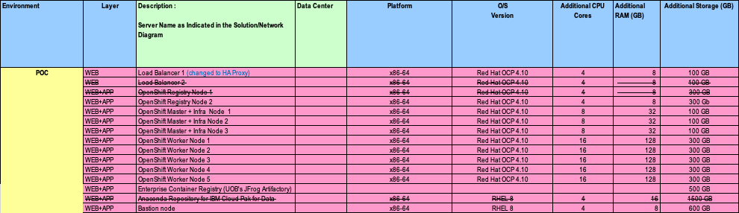
POC infrastructure requirements shared with UOB
Note: HA Proxy is currently being used

Slide 5



POC Infrastructure Deployment Architecture
Existing UOB Infrastructure
IBM POC Components
Push images
Push Conda Packages
Conda pakcages will be used from JFrog
Indicates VM or Baremetal Server
Copy Images / Conda Packages from Airgap storage / HDD
(12)
Bastion node
(6)
Enterprise Container Registry (UOB's JFrog Artifactory)
(13) Anaconda Repository for IBM Cloud Pak for Data
…
Package lifecycle management
CP4D Platform Connection (JDBC/ODBC etc)
Teradata / Cloudera Cluster
OC / CPD-CLI Commands
Data Engineer
Data Scientist
HTTP/S
HTTP/S
(1)
HA Proxy
(7,8,9,10,11)
OpenShift Worker Nodes
Persistent Volume
(5)
OpenShift Registry node – Part of UOB’s existing OCP Cluster
(14)
2 TB NFS Shared Storage
(2,3,4)
OpenShift Master/Infra Nodes – Part of UOB’s existing OCP Cluster
Deployer
Model Ops
Services deployed as pods on OpenShift worker nodes
Watson Knowledge Catalog (Governance Catalog)
Watson Studio (Notebooks etc)
Watson Query (Data Virtualization)
SPSS Modeller (Low-code data science)
Analytics dashboards
AutoAI
Watson Machine Learning (ML runtime)
Watson OpenScale (Model monitoring & explain ability)
Watson Pipeline (Create an end-to-end flow of assets from creation through deployment)
IBM OpenPages (Model Risk Governance)
AI Factsheets (Model Metadata)

Slide 6
Application & Data sources connectivity required
Source | Details
LDAP | For connection to Cloudera Hive, Impala and HDFS
JFrog – Anaconda
Source | Details
Parquet files
SAS files
Cloudera Hive | Use cases would be
Cloudera Impala
MariaDB
Teradata
EDAG
API ?
Filestore

Slide 7
LDAP groups
Administrator - nla_map_adm_grp_sit
Data Engineer- nla_map_adm_de_sit
Data Scientist - nla_map_adm_ds_sit
Developer - nla_map_adm_dev_sit
Reporting Admin - nla_map_adm_rep_sit
Data Quality Analyst - nla_map_adm_dqa_sit

Slide 8
Kerberos Integration steps- Cloudera Impala
Prerequisite for Kerberos authentication
To use Kerberos authentication, the data source must be configured for Kerberos and the service that you plan to use the connection in must support Kerberos. For information, see Enabling platform connections to use Kerberos authentication.
Create a connection to Cloudera Impala
To create the connection asset, you need these connection details:
Database name
Hostname or IP address
Port number
Username and password
SSL certificate (if required by the database server)
Authentication method
You can choose Kerberos credentials or Username and password. For Kerberos credentials, you must complete the prerequisite for Kerberos authentication and you need the following connection details:
Service principal name (SPN) that is configured for the data source
User principal name to connect to the Kerberized data source
The keytab file for the user principal name that is used to authenticate to the Key Distribution Center (KDC)

Slide 9
Kerberos Integration steps- Hive
Prerequisite for Kerberos authentication
To use Kerberos authentication, the data source must be configured for Kerberos and the service that you plan to use the connection in must support Kerberos. For information, see Enabling platform connections to use Kerberos authentication.
Create a connection to Apache Hive
To create the connection asset, you need these connection details:
Database name
Hostname or IP address
Port number
HTTP path (Optional): The path of the endpoint such as the gateway, default, or hive if the server is configured for the HTTP transport mode.
SSL certificate (if required by the database server)
Authentication method
You can choose Kerberos credentials or Username and password. For Kerberos credentials, you must complete the prerequisite for Kerberos authentication and you need the following connection details:
Service principal name (SPN) that is configured for the data source
User principal name to connect to the Kerberized data source
The keytab file for the user principal name that is used to authenticate to the Key Distribution Center (KDC)

Slide 10
Kerberos Integration steps- Apache HDFS
Create a connection to Apache HDFS
To create the connection asset, you need these connection details. The WebHDFS URL is required. The available properties in the connection form depend on whether you select Connect to Apache Hive so that you can write tables to the Hive data source.
WebHDFS URL to access HDFS.
Hive host: Hostname or IP address of the Apache Hive server.
Hive database: The database in Apache Hive.
Hive port number: The port number of the Apache Hive server. The default value is 10000.
Hive HTTP path: The path of the endpoint such as gateway/default/hive when the server is configured for HTTP transport mode.
SSL certificate (if required by the Apache Hive server).
Authentication method
You can choose Kerberos credentials or Username and password.
For Kerberos credentials, you must complete the prerequisite for Kerberos authentication and you need the following connection details. You also need these details for Hive if you selected Connect to Apache Hive:
Service principal name (SPN) that is configured for the data source.
User principal name to connect to the Kerberized data source.
The keytab file for the user principal name that is used to authenticate to the Key Distribution Center (KDC).
For Username and password, you also provide values for the Hive user and password if you connect to Apache Hive.

Slide 11
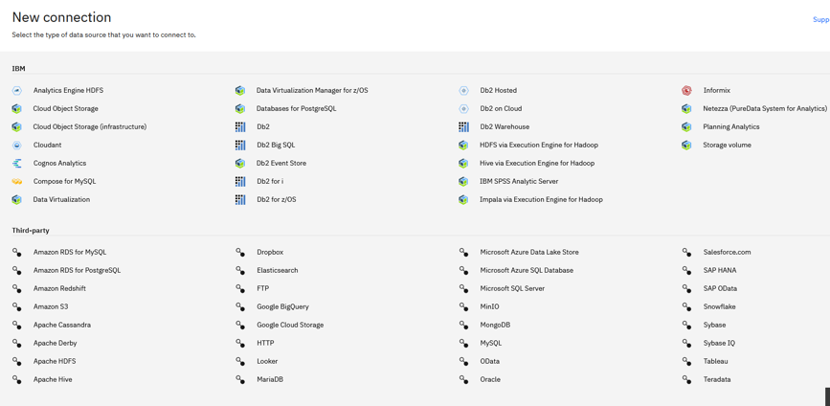
B1.3.1 & B1.3.3: Data Sources
The solution allows Data Access with many types of Data source connections with API or Library support for Python or R and in-built integration with Platform connections for Low/No code Model Development Tooling
Platform connections which can be reused in different Projects
Data Catalog based connections which can allow organizing connections and restricting access based on access control
Project scoped access which is local to a Project team
All data sources require standards-based credentials and can be Promoted to Deployment Spaces (Watson Machine Learning during Model Deployment) for use within the Model Operations environment

Slide 12

Custom Data Access
05
Create Data Protection Rule
Create Data Connections to additional sources
Data Virtualization using Watson Query
Ad-hoc csv file upload

Slide 13










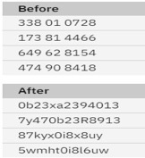

B1.7.8: Application Security (Protection of PII / Sensitive Data)
PII
Single point of control
Single point of enforcement
Classification
Pre-defined
Extensible
Data Classes
Email
NRIC | Suspect (Y/N) | Phone | Age | Email | Credit Card
Column / Fields
One rule
If classification = ‘PII’’ and business term = ‘suspect’ then mask column
Data Consumer (e.g. Data Scientist)

Slide 14
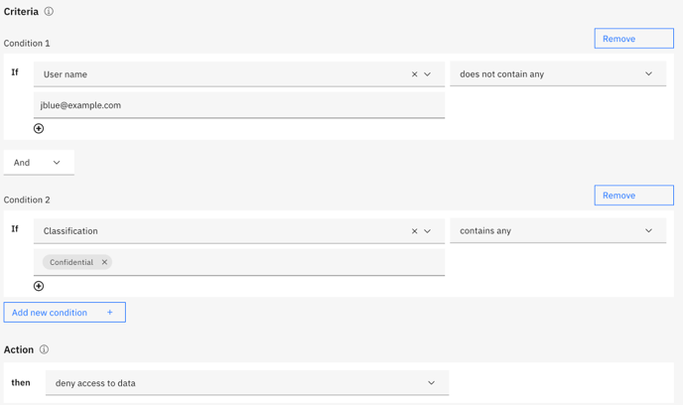
B1.7.8: Security – Sensitive Data Protection
Data Protection Rules
Create data protection rules to protect sensitive data based on the identity of the user and properties or characteristics of the data.
A data protection rule is evaluated for enforcement when a user accesses an asset in a governed catalog. Enforcement of the rule can affect the appearance of the data and whether the data asset can be moved out of the catalog for use
Cloud Pak for Data supports protection of data at rest and in motion. It supports FIPS (Federal Information Processing Standard) compliant encryption for all encryption needs.
Catalog
create catalog and is collaborator
[Manage catalogs]
Is collaborator [Access catalogs]
e.g. If the user is not jblue@example.com and if any data is classified as Confidential, then deny access to the data in the asset.

Slide 15

B1.1.13 - (Ability to support single centralized repository for all models and policy related objects with partitioning based on user groups)
A Catalog
A catalog is how you share assets across your enterprise
Collaborators: Including data stewards, data quality analysts, data scientists, data engineers etc can be granted levels of access such as viewer or admin
The default catalog is created automatically. It allows automated data discovery to import metadata, assign governance artifacts, and analyse the quality of datasets
Database Table
Connection
Report
Custom Asset Type
Collaborators
- Data steward
- Data quality analyst
- Data scientist
- Data engineer
- Admin
Models
Scripts
Data assets can include both relational data and unstructured data, such as PDF or Microsoft Office documents.

Slide 16
B1.3.3 & B1.3.16: Ability to allow ad-hoc data upload on the platform by end users. Please elaborate on types of data allowed and formats supported (i.e. customer data in CSV) format)
Type of data file | Supported in
Avro | SPSS Modeller, Watson Knowledge Catalog, Watson Studio
CSV, TSV | Watson Query, SPSS Modeler, Watson Knowledge Catalog, Watson Studio
JSON | Watson Query, Watson Knowledge Catalog, Watson Studio
Microsoft Excel spreadsheets | Watson Query, SPSS Modeler Watson Knowledge Catalog, Watson Studio
ORC | Watson Query
Parquet | Watson Query, Watson Knowledge Catalog, Watson Studio
SAS | SPSS Modeler, Watson Studio (Data Refinery)
SAV, XML | SPSS Modeler

Slide 17
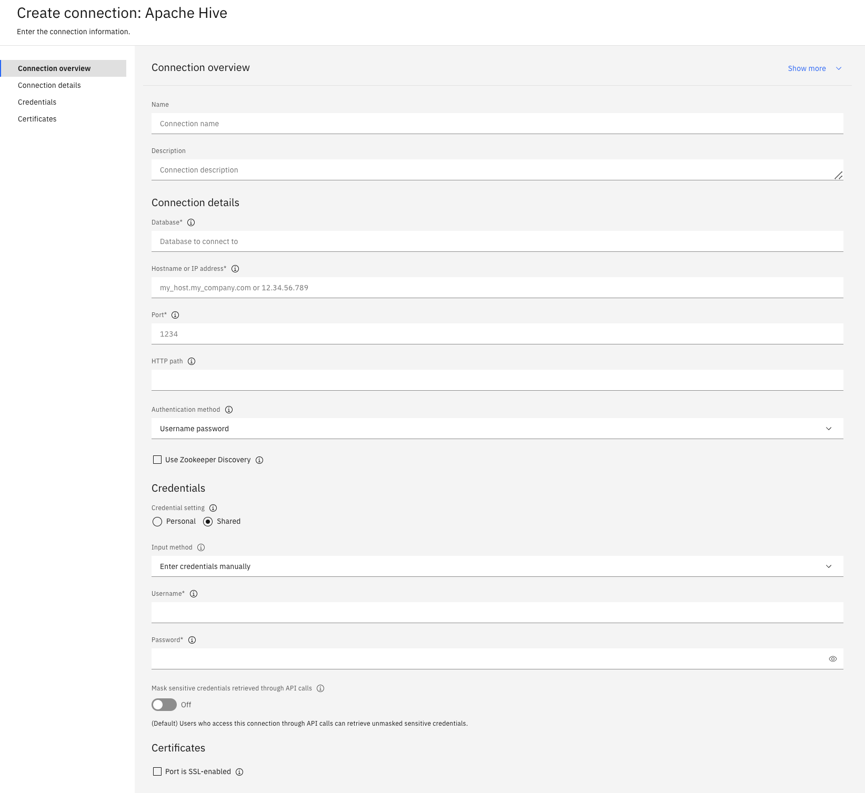
Apache Hive

Slide 18
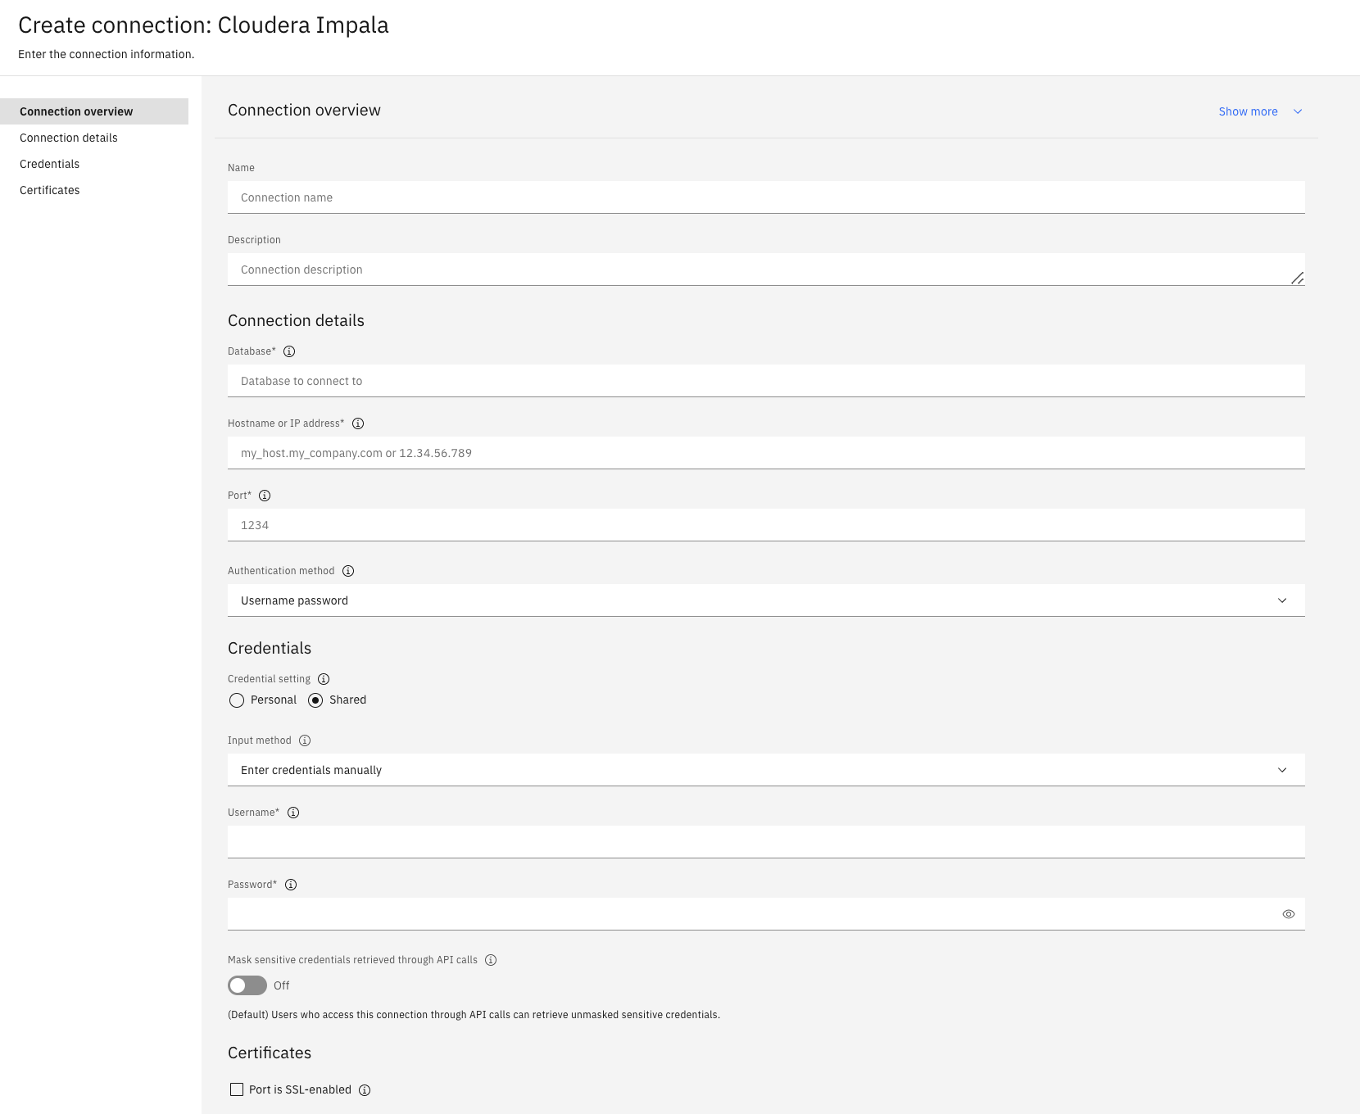
Cloudera Impala

Slide 19
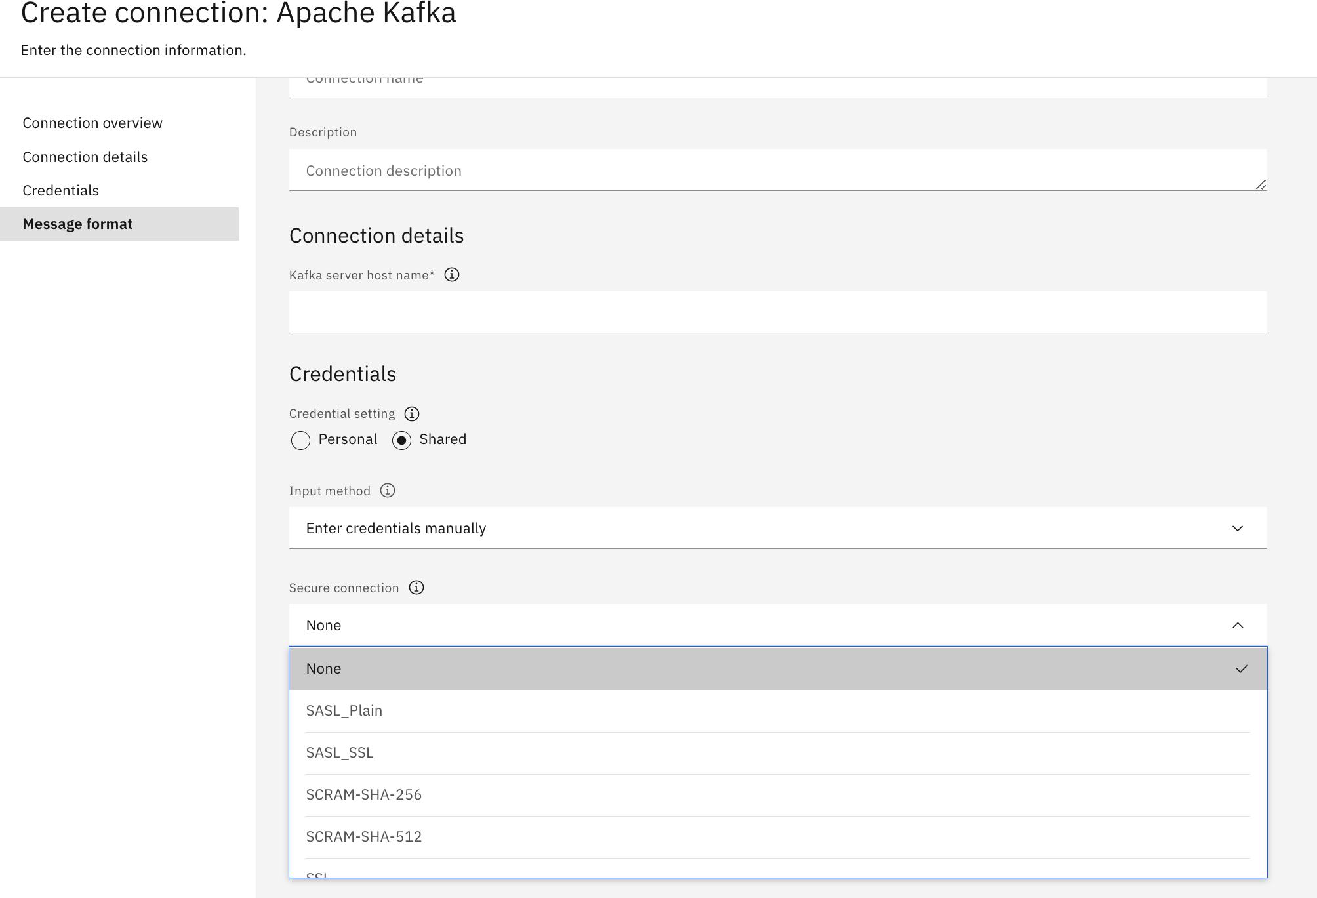
Kafka connection

Slide 20
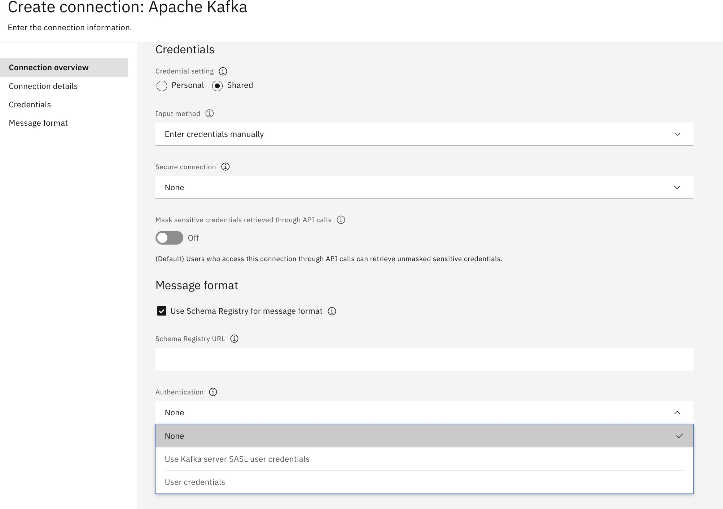
Kafka connection

Slide 21
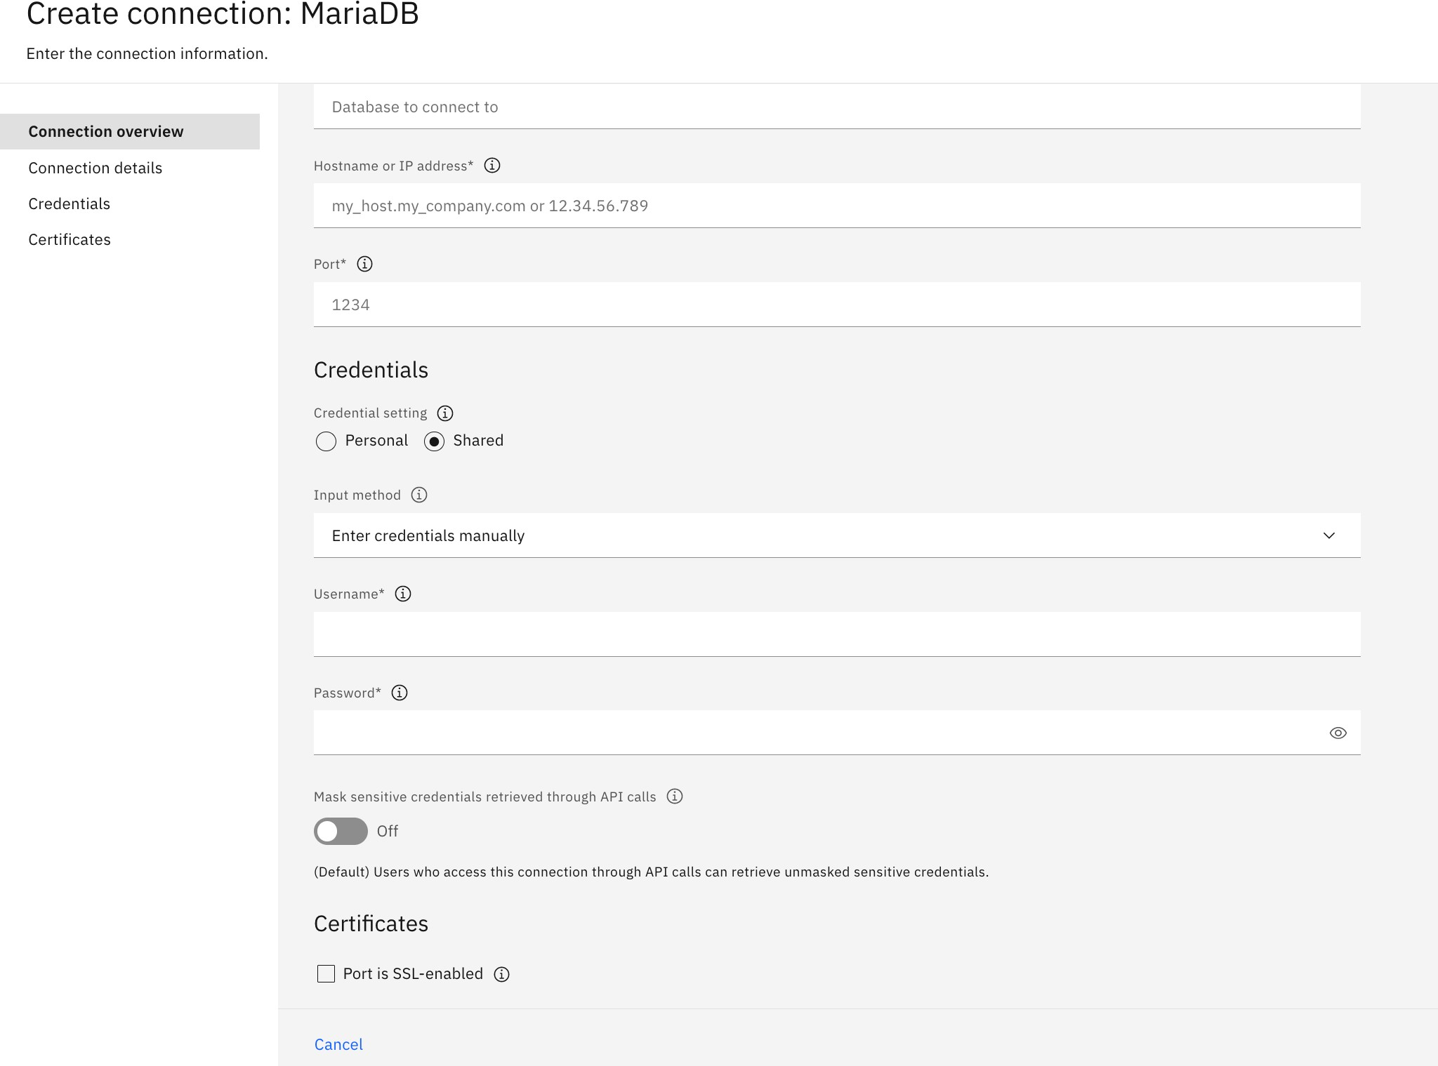
MariaDB Connection

Slide 22
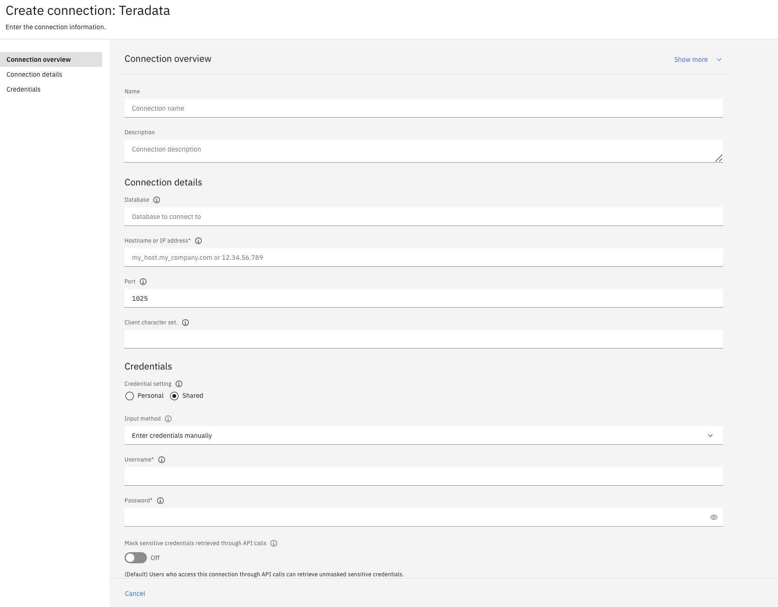
Teradata

Slide 23



B1.3.7, B1.3.11 & B1.3.12: What is Data Virtualization
Data virtualization enables access to physical data from various sources, in a virtual manner, so that the data can be accessed, manipulated, and analyzed, without needing to know its physical format or location, and without having to move or copy it.
Connect, access, and govern any data without the need for data movement
Access structured and unstructured disparate data on demand, without the need for ETL or creation of copies.
Abstract complexity from data consumers
A virtual semantic layer across all your data sources allows users to quickly connect to, join, and analyze data from multiple sources without needing to understand back-end database technologies.
Create virtual views over multiple data sources
No need for transformations; create a virtual view of required data that can be shared within your organization.
Governance integration and security
Controlled, governed and secure access to virtual data sets through native integration with Watson Knowledge Catalog.
Appears as if all tables are in the same database
Virtual Tables represent the physical data
Physical Tables

Slide 24
B1.3.7, B1.3.11 & B1.3.12: What is IBM Watson Query
A universal data access layer that automates how you access and unify data across any source or type (clouds, warehouses, lakes, etc.) with data virtualization, without the need for data movement or replication
Watson Query Experience
Data Science
Business Intelligence
AI Apps
One query experience over multiple data sources, types, and form factors
Integrated governance with Watson Knowledge Catalog to provide governed data access
Open data formats to work with data on any cloud and on-premises (Parquet, Orc, CSV, TSV)
Real-time data integration without data movement
Intelligent cache recommendation accelerating query performance with minimal user input
Unified Ops
Self-Service
End-to-end Governance, Security, Compliance
IBM Watson Query
Virtual Tables
Connection Layer
Data Sources
COS
Blob Storage
Cloud Storge
S3
Db2
Netezza
Teradata
IBM Cloud
Cloudera
Azure
GCP
AWS
Snowflake
Oracle
… and more!
Cloud Data Lake
Database and Warehouse
Any Data, Anywhere.

Slide 25
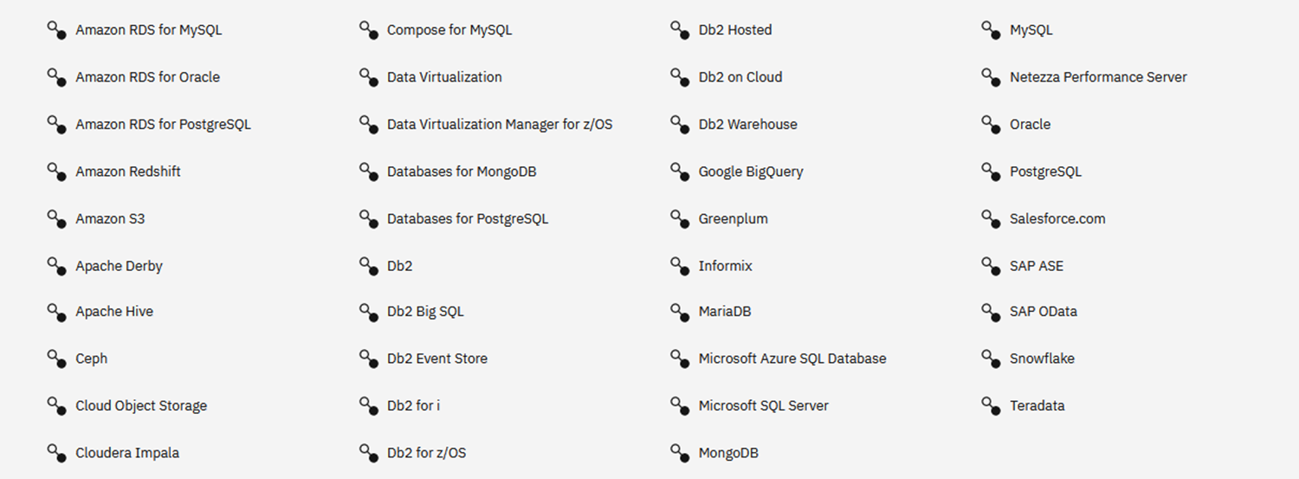
B1.3.7, B1.3.11 & B1.3.12 : Broad support for Data Sources
New sources continually added!

Slide 26
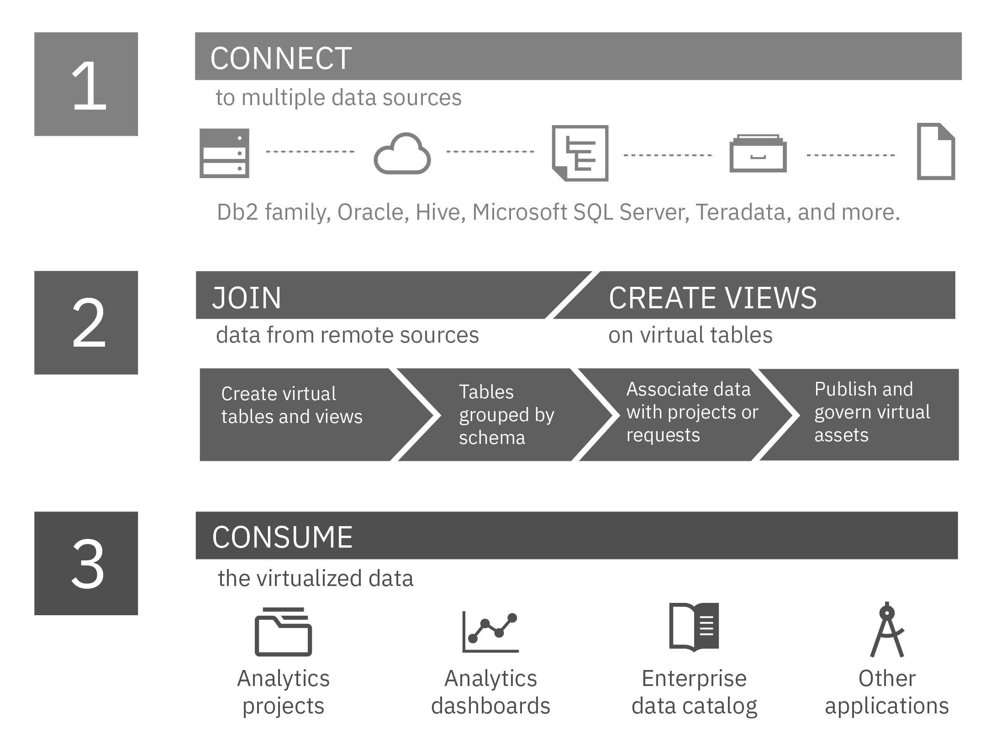
B1.3.3 (3) About Watson Query
Size limits: Watson Query supports virtualization of tables with a row size up to 1 MB, and up to 2048 columns in a table. However, the number of columns that Watson Query can preview depends on many factors, such as the data types of the columns. Currently, preview is limited to 200 columns.
File formats: Watson Query supports PARQUET (or PARQUETFILE), ORC (optimized row columnar), CSV (comma-separated values), TSV (tab-separated values), and JSON file formats. Metadata is extracted from the data file.
For CSV and TSV files: Cloud Pak for Data automatically detects the encoding scheme of flat data files, such as CSV and TSV files.
https://www.ibm.com/docs/en/cloud-paks/cp-data/4.6.x?topic=connectors-setting-character-encoding-scheme

Slide 27
Data Virtualization scenario
A deep analysis of a business' customer engagements and sales.
The business has customer data residing across multiple disparate data sources, including a relational Db2 data warehouse, a relational PostgreSQL database, and Amazon S3 object storage.
CUSTOMER: Main customer details, including name, address, and credit card information. This table is hosted in a Db2 Warehouse relational database.
CUSTOMER_LOYALTY: Customer loyalty and sales information from 2016 onward. This table is hosted in a PostgreSQL relational database.
CUSTOMER_LOYALTY_HISTORY: Archived customer loyalty information from 2010-2015. This data is stored in a CSV file on Amazon S3 object storage.

Slide 28
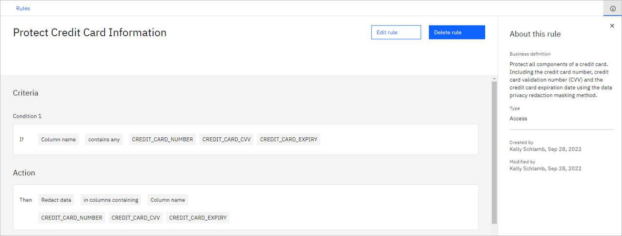
Data Virtualization – Rule created

Slide 29
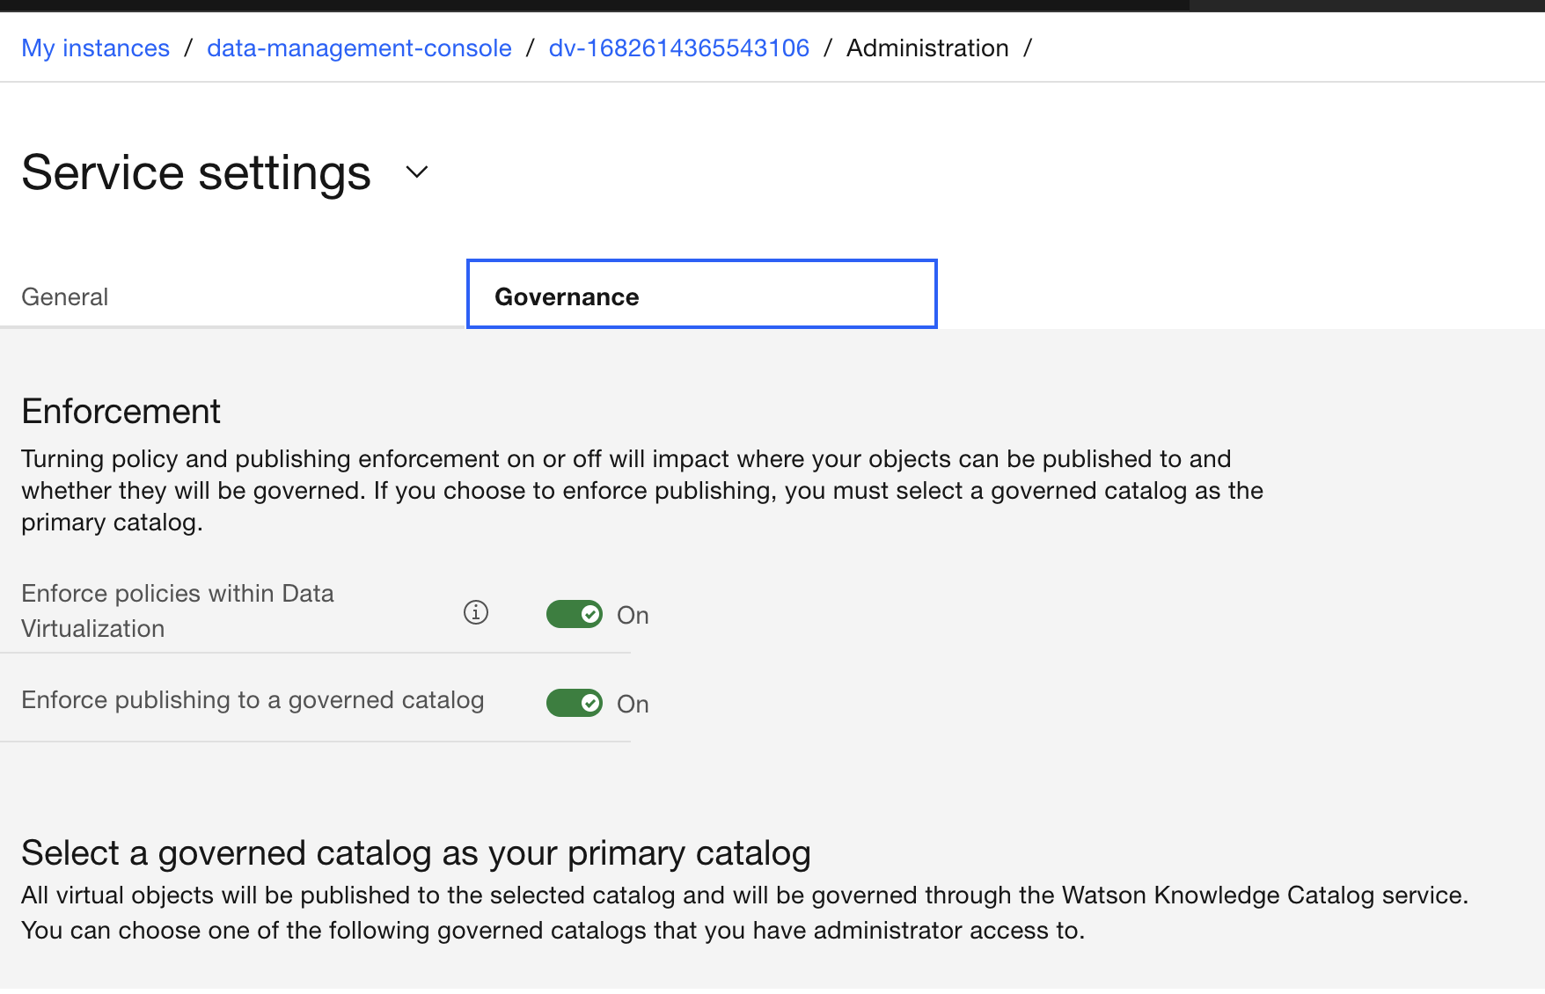
Data Virtualization -Governance
Data > Data virtualization.
Administration > Service settings
Select Governance tab
Toggle the Enforce policies within Data Virtualization switch to On. .

Slide 30
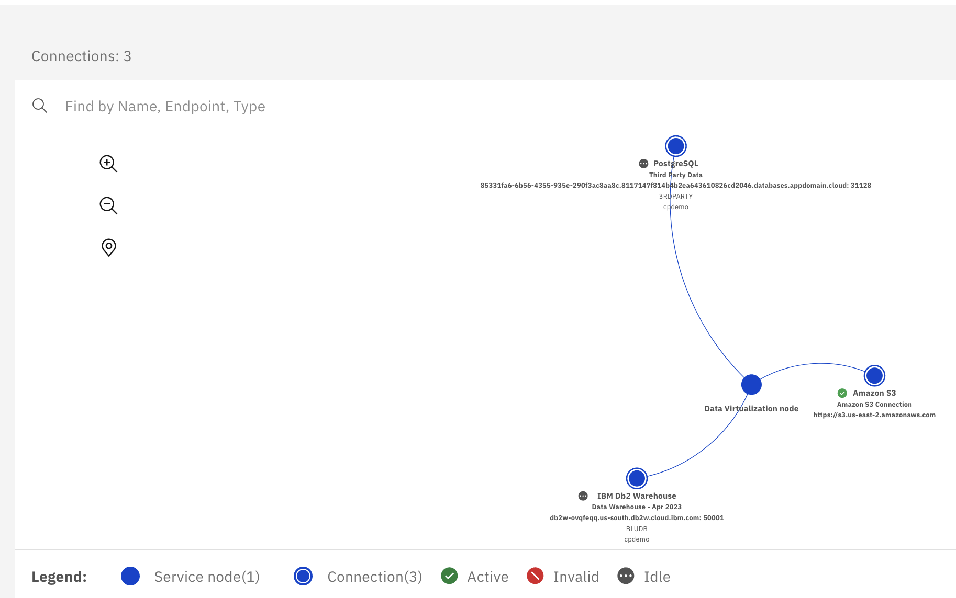
Define Data Sources
Select Virtualization > Data sources from the side menu. Click Add connection + in the upper-right corner and then select Existing platform connection.
When prompted with the Confirm to continue pop-up message, click Confirm.
Select the radio button for the Data Warehouse (IBM Db2 Warehouse) connection.
Click Add. Data sources:
Show PostgreSQL Data Source
Show Amazon S3 Data Source
Show constellation view
A remote connector enables the virtualization of data that is stored on a file system or a remote data source that is not directly accessible by Watson Query.

Slide 31
Virtualize data
Rather than you manually searching through the database data source – looking for tables across the many schemas in a Db2 or Oracle database, for instance – it will automatically scan the database (based on the permissions of the user used for the connection) and present the data objects found to you. You can then choose to create virtual tables as needed, based on the objects listed.
Select Virtualization > Virtualize from the side menu. Click list
Hundreds of tables are listed. Where did all these tables come from? Watson Query discovered them from your database connections!
In the Filter by bar, click on the Source type, Database, and Schema dropdown selection menus to get a feel for the type of filtering that can be done.
In the Find tables by name, schema, column, or business term search field, enter CUSTOMER.
Check the boxes for both the CUSTOMER and CUSTOMER_LOYALTY tables.
Note: The auto-discovery operation may take a minute or two to complete and so you might not see both of these tables listed initially. You may also see pop-up messages saying things like "Tables were added or updated. Click Reload to load the tables." and "All listed tables are loaded: Click Refresh to update the list." Click to reload and refresh as needed and both of these tables should eventually show up.
Click Add to cart.
Click View cart (2) (the “2” represents the two tables that you added to the cart) to advance to the Review cart and virtualize tables page.
Watson Query gives clients the flexibility to customize virtual tables based on their needs. For example, on this Review cart and virtualize tables page, you can choose to rename the schema and/or table names, as well as remove columns or change the name and type of columns within the tables. For this lab, leave the schema and table names as they are. The source of the schema name (which is unique to you) will be explained later in the lab.

Slide 32
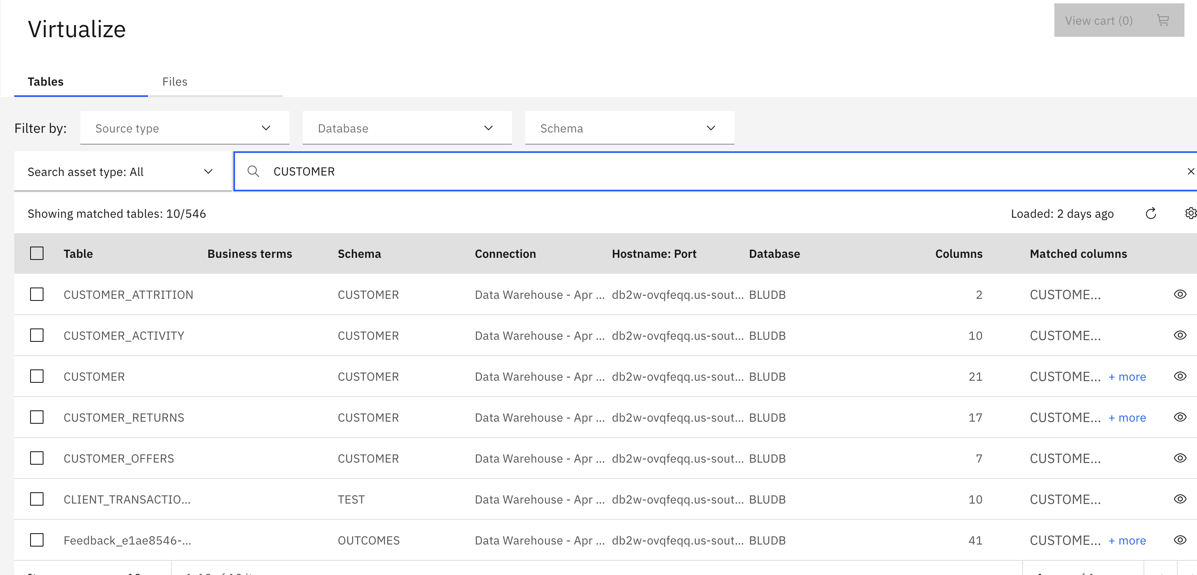
Virtualize data
CUSTOMER: Main customer details, including name, address, and credit card information. This table is hosted in a Db2 Warehouse relational database.
CUSTOMER_LOYALTY: Customer loyalty and sales information from 2016 onward. This table is hosted in a PostgreSQL relational database.
CUSTOMER_LOYALTY_HISTORY: Archived customer loyalty information from 2010-2015. This data is stored in a CSV file on Amazon S3 object storage.
Select Virtualization > Virtualize from the side menu.
In the Find tables by name, schema, column, or business term search field, enter CUSTOMER.
Check the boxes for both the CUSTOMER and CUSTOMER_LOYALTY tables.
Click Add to cart.
Click View cart (2) (the “2” represents the two tables that you added to the cart) to advance to the Review cart and virtualize tables page.
Within the Objects to be virtualized section, click the vertical ellipsis at the right side of the row for the CUSTOMER table and select Edit columns.
Uncheck the rows associated with the GENDER and EDUCATION columns (these columns were chosen arbitrarily, simply as an example of how to do this).
Click the Apply button in the upper-right corner.
Unselect the Assign to project check box. By doing this, the table won't be added to any project, but it will be available in the Virtualized data section of the console (which you will see later).
Click the Virtualize button in the upper-right corner.
The virtualization process has started for the CUSTOMER and CUSTOMER_LOYALTY tables. Click Virtualize more data.

Slide 33
Virtualizing Data from Object Storage Files
For files located in object storage, you start by selecting the endpoint URL and then work your way through the bucket and any folders as needed to locate the file(s) you want to virtualize as a table in Watson Query.
Select the Files tab.
Click the https://s3.us-east-2.amazonaws.com endpoint URL link
Select the cpd-outcomes-s3 bucket on the left
Select the Customer folder.
Select CUSTOMER_LOYALTY_HISTORY.csv.
Click Add to cart.
Click View cart (1).
Unselect the Assign to project check box. By doing this, the table won't be added to any project, but it will be available in the Virtualized data section of the console (which you will see later).
Change the table name from CUSTOMER_LOYALTY_HISTORY_csv to CUSTOMER_LOYALTY_HISTORY.
Click the vertical ellipsis at the right side of the row for the CUSTOMER_LOYALTY_HISTORY table and select Edit columns.

Slide 34
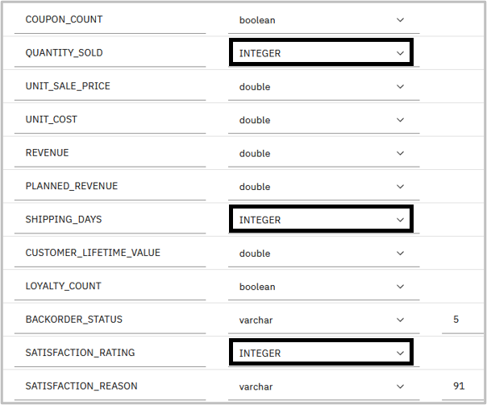
Virtualizing Data from Object Storage Files
Click the vertical ellipsis at the right side of the row for the CUSTOMER_LOYALTY_HISTORY table and select Edit columns.

Slide 35
Virtualizing Data from Object Storage Files
When profiling the data, three columns may incorrectly be assigned the wrong type. Make the following changes to the columns listed (if they are not already assigned the Int (integer) type):
QUANTITY_SOLD: Change type to INTEGER
SHIPPING_DAYS: Change type to INTEGER
SATISFACTION_RATING: Change type to INTEGER
Scroll up and click the Apply button in the upper-right corner.
Back on the Review cart and virtualize tables screen, click the Virtualize button in the upper-right.
14. The virtualization process has started for the CUSTOMER_LOYALTY_HISTORY table. Click Go to virtualized data.
The three tables are now available for access through Watson Query (and have been published to the catalog). Virtual views can also be created "on top of" the virtual tables.

Slide 36
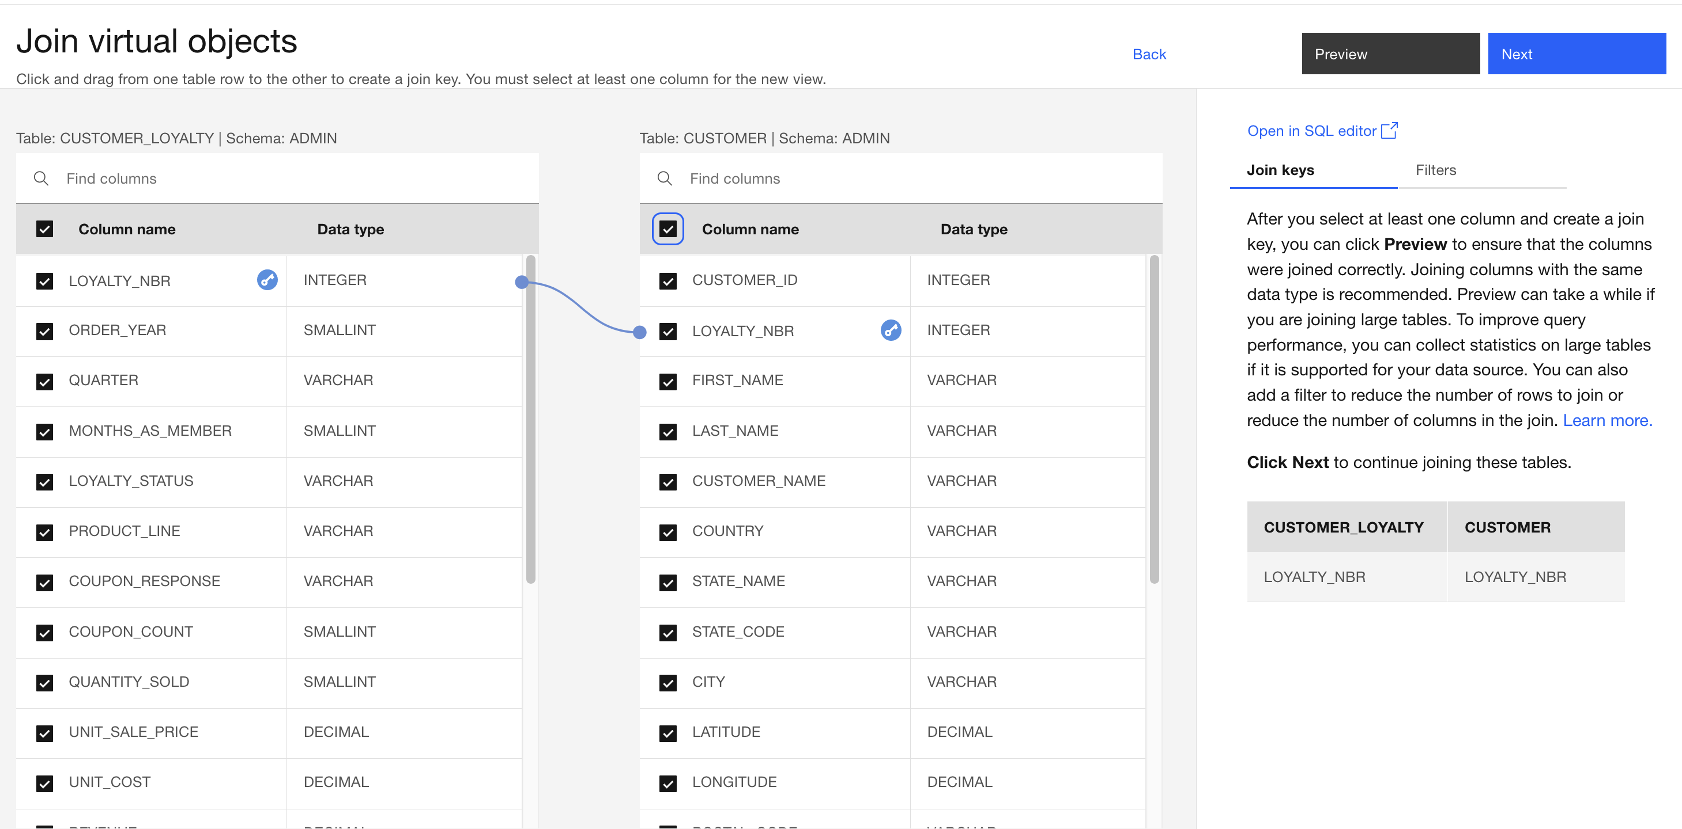
Create Virtual Views
In Watson Query, there are two options available for creating a view that joins tables (or other views) together. One approach is to use the graphical interface and the other is to create it manually by running a CREATE VIEW SQL statement. The graphical approach is very simple and intuitive, whereas the SQL approach is more flexible. A SQL statement allows for very specific filtering, the ability to join more than two tables at once, and more choices on the type of join used (inner join, left outer join, right outer join, full outer join, and so on).
Check the boxes for both the CUSTOMER and CUSTOMER_LOYALTY tables.
Click Join on the right.
Select the check box in the Column name header for the table on the left (which will select every column in the table).
Select the check box in the Column name header for the table on the right (which will select every column in the table).
Put your cursor focus on the LOYALTY_NBR row in the table on the left and click on it, without releasing the mouse button (nothing will happen yet).
Holding the mouse button down, drag the connection line that appears when you start moving the cursor...
... and connect the line to the LOYALTY_NBR row of the table on the right.
A blue line will appear, connecting these two columns as the join key. Note the key icons that appear – they indicate that the join key is comprised of the LOYALTY_NBR columns in the two tables.

Slide 37
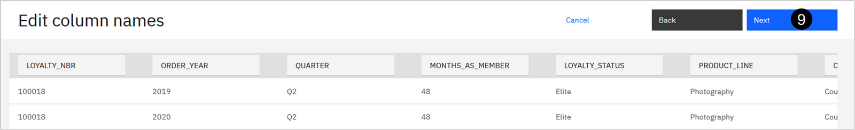
This screen allows you to modify the column names, but don’t modify any of them. Click Next

Slide 38
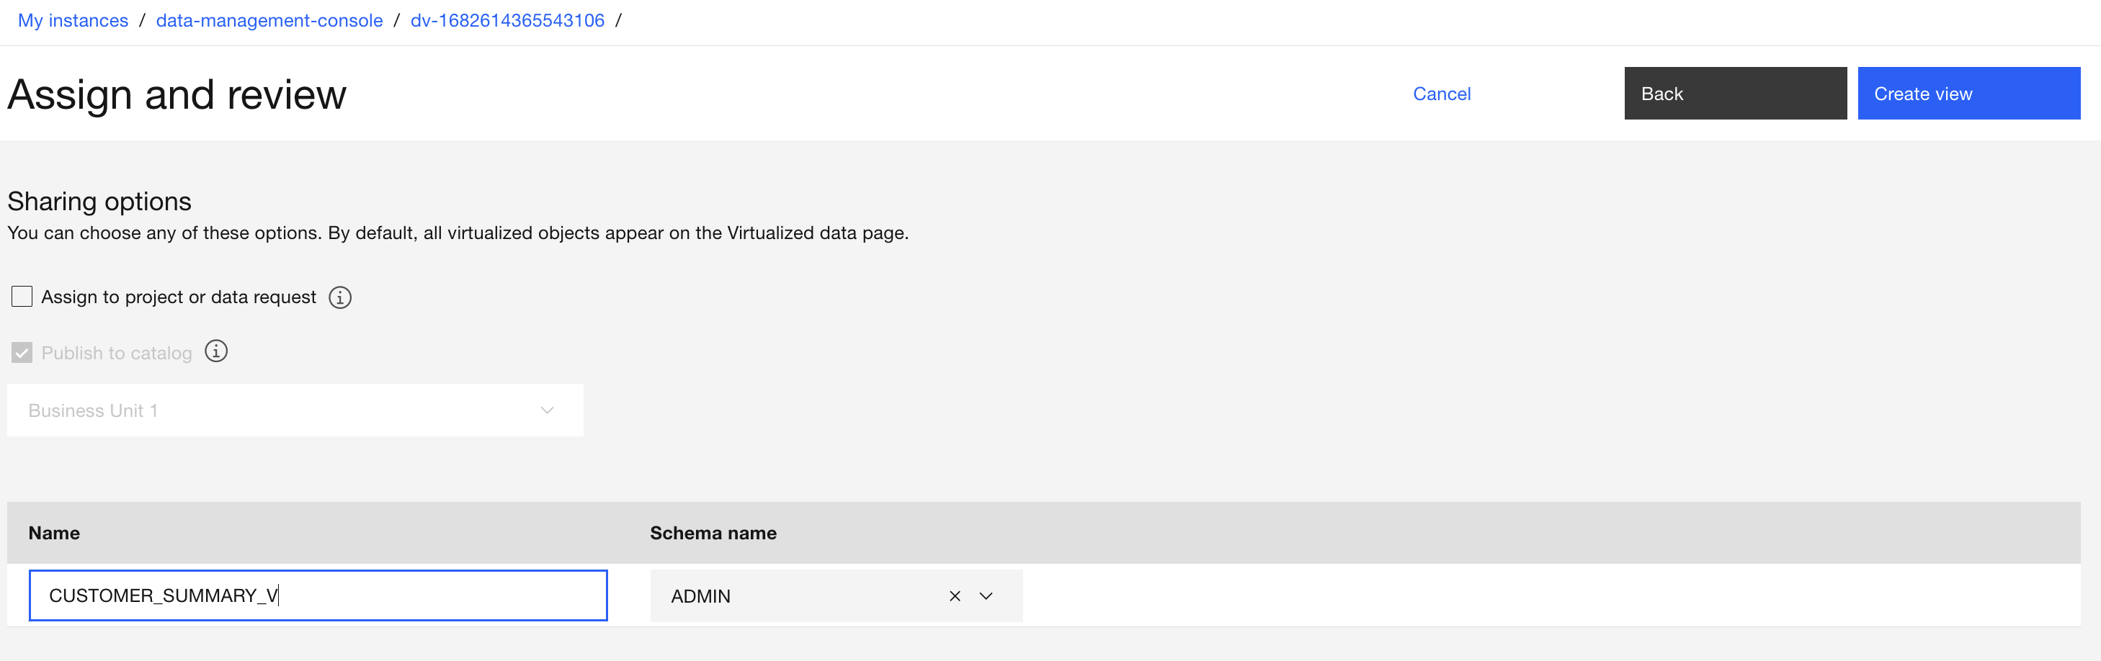
Create Virtual Views
Unselect the Assign to project check box. By doing this, the view won't be added to any project, but it will be available in the Virtualized data section of the console (which you will see later).
Enter CUSTOMER_SUMMARY_V for the View name. (Duplication checking is performed as you type and if you see a message stating that the view name already exists, finish typing and wait for the message to disappear.)

Slide 39
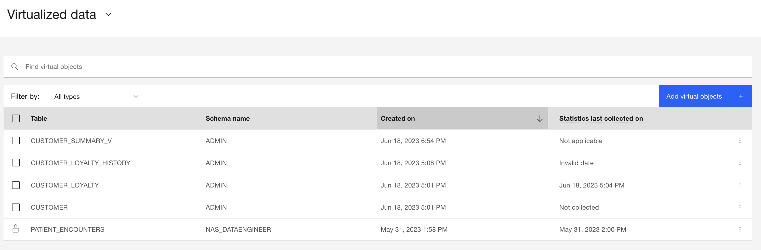
Create Virtual Views
The view has been created successfully.
Click Go to virtualized data.
You should see the CUSTOMER_SUMMARY_V view in your list of virtualized data objects. Next, you will create a view by specifying a SQL statement.

Slide 40
Create Virtual Views
Note: The order of the two tables that you see might not match the image above (CUSTOMER might be on the left with CUSTOMER_LOYALTY on the right). That is okay as the instructions below still apply.
Like you did earlier, check the boxes for both the CUSTOMER and CUSTOMER_LOYALTY tables.
Click Join on the right.
Select the check box in the Column name header for the table on the left (which will select every column in the table).
Select the check box in the Column name header for the table on the right (which will select every column in the table).
Put your cursor focus on the LOYALTY_NBR row in the table on the left and click on it, without releasing the mouse button (nothing will happen yet).
Holding the mouse button down, drag the connection line that appears when you start moving the cursor...
... and connect the line to the LOYALTY_NBR row of the table on the right.
A blue line will appear, connecting these two columns as the join key. Note the key icons that appear – they indicate that the join key is comprised of the LOYALTY_NBR columns in the two tables.
You are about to provide your own definition for the view, so why do this work to specify the columns to include and the join key here? The console doesn't permit you to click the Open in SQL editor link until you've done this. Generally, you would use this approach to construct the view as much as possible with the graphical interface and then tweak the final definition using the editor.
Click Open in SQL editor.
When warned about returning to the Join virtual objects page after creating the view through SQL, click Continue.
A CREATE VIEW SQL statement is pre-populated in the SQL Editor. The view definition includes the columns you selected from the tables on the previous screen, along with the join key you specified.
At this point you can modify the pre-populated statement or completely replace it with your own statement. If your intention is to create a view that you otherwise could have created using the graphical approach, but there was logic or behavior you couldn’t specify – such as a specific type of join – then you would want to use this combined approach. In that case, do exactly what you did here to specify the columns involved and the join key and then tweak the statement as needed in the SQL Editor before running it.
If you have a CREATE VIEW statement designed already (like in this example) then you also have the option of running it in the Run SQL section of the console (which you will experience later) or using a 3rd party SQL editor connected into the environment.

Slide 41
Create Virtual Views
Replace the pre-populated CREATE VIEW statement with the statement below:
CREATE VIEW CUSTOMER_SUMMARY_V2 AS
SELECT CUSTOMER.CUSTOMER_ID AS CUSTOMER_ID, CUSTOMER.LOYALTY_NBR AS LOYALTY_NBR, CUSTOMER.FIRST_NAME AS FIRST_NAME,
CUSTOMER.LAST_NAME AS LAST_NAME, CUSTOMER.CUSTOMER_NAME AS CUSTOMER_NAME, CUSTOMER.COUNTRY AS COUNTRY,
CUSTOMER.STATE_NAME AS STATE_NAME, CUSTOMER.STATE_CODE AS STATE_CODE, CUSTOMER.CITY AS CITY,
CUSTOMER.LATITUDE AS LATITUDE, CUSTOMER.LONGITUDE AS LONGITUDE, CUSTOMER.POSTAL_CODE AS POSTAL_CODE,
CUSTOMER.LOCATION_CODE AS LOCATION_CODE, CUSTOMER.INCOME AS INCOME, CUSTOMER.MARITAL_STATUS AS MARITAL_STATUS,
CUSTOMER.CREDIT_CARD_TYPE AS CREDIT_CARD_TYPE, CUSTOMER.CREDIT_CARD_NUMBER AS CREDIT_CARD_NUMBER,
CUSTOMER.CREDIT_CARD_CVV AS CREDIT_CARD_CVV, CUSTOMER.CREDIT_CARD_EXPIRY AS CREDIT_CARD_EXPIRY,
CUSTOMER_LOYALTY.ORDER_YEAR AS ORDER_YEAR, CUSTOMER_LOYALTY.QUARTER AS QUARTER,
CUSTOMER_LOYALTY.MONTHS_AS_MEMBER AS MONTHS_AS_MEMBER, CUSTOMER_LOYALTY.LOYALTY_STATUS AS LOYALTY_STATUS,
CUSTOMER_LOYALTY.PRODUCT_LINE AS PRODUCT_LINE, CUSTOMER_LOYALTY.COUPON_RESPONSE AS COUPON_RESPONSE,
CUSTOMER_LOYALTY.COUPON_COUNT AS COUPON_COUNT, CUSTOMER_LOYALTY.QUANTITY_SOLD AS QUANTITY_SOLD,
CUSTOMER_LOYALTY.UNIT_SALE_PRICE AS UNIT_SALE_PRICE, CUSTOMER_LOYALTY.UNIT_COST AS UNIT_COST,
CUSTOMER_LOYALTY.REVENUE AS REVENUE, CUSTOMER_LOYALTY.PLANNED_REVENUE AS PLANNED_REVENUE,
CUSTOMER_LOYALTY.SHIPPING_DAYS AS SHIPPING_DAYS, CUSTOMER_LOYALTY.CUSTOMER_LIFETIME_VALUE AS CUSTOMER_LIFETIME_VALUE,
CUSTOMER_LOYALTY.LOYALTY_COUNT AS LOYALTY_COUNT, CUSTOMER_LOYALTY.BACKORDER_STATUS AS BACKORDER_STATUS,
CUSTOMER_LOYALTY.SATISFACTION_RATING AS SATISFACTION_RATING, CUSTOMER_LOYALTY.SATISFACTION_REASON AS SATISFACTION_REASON
FROM CUSTOMER, CUSTOMER_LOYALTY
WHERE CUSTOMER.LOYALTY_NBR=CUSTOMER_LOYALTY.LOYALTY_NBR;

Slide 42
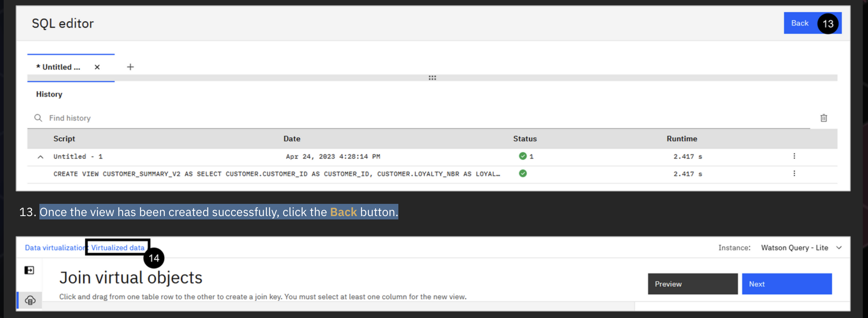
Create virtual views
Click the Format the statements in the editor (</>) button (in the middle of the tool bar above the SQL statement). This nicely formats the SQL statement.
Click Run all.
Once the view has been created successfully, click the Back button.

Slide 43
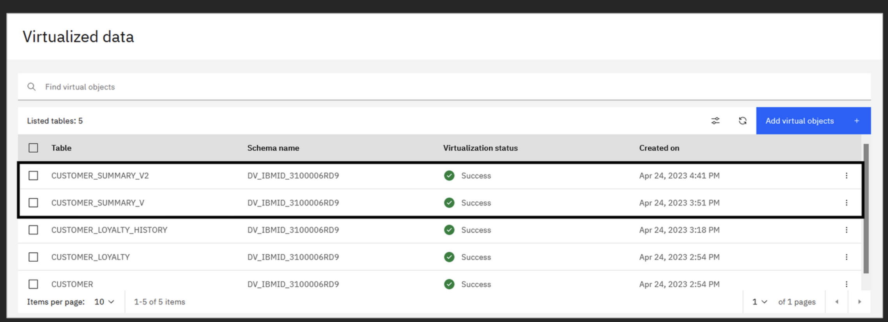
Explore virtual view
Click Virtualized data in the breadcrumb at the top of the screen
You should now see both the CUSTOMER_SUMMARY_V and the CUSTOMER_SUMMARY_V2 views in your list of virtualized data objects.

Slide 44
Manage access
Take a closer look at one of the views you just created:
Click the vertical ellipsis at the right side of the row for the CUSTOMER_SUMMARY_V view.
Notice all of the various things you can do with the view, such as viewing details about it (which includes previewing the data), managing access, and publishing the view to a catalog. Select View details to preview the data in the view.
Note: You may need to wait a few seconds for the rows to be displayed. The preview area will remain blank (showing "0 Columns" and "0 Rows") until the rows are loaded.

Slide 45
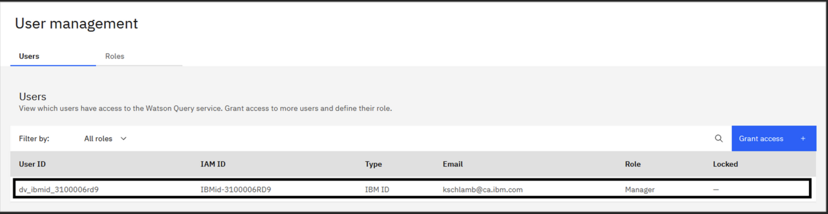
Manage access
Manage Access
Virtual objects can be accessed by applications through Watson Query. More specifically, an application can connect to Watson Query and issue queries against the objects that the application has access to (based on the user associated with the connection).
There are two levels of access control that need to be managed. First, at the Watson Query level – where users need to be added and assigned roles. Second, at the individual object level – where users are granted access to an object in order to view and query the data associated with it.
1. Select Administration > User management from the side menu. You should start in the Users tab by default.

Slide 46
Manage access
When a user is added to the Watson Query environment, it is assigned a User ID that is unique to the service itself. This user ID is of the form dv_ibmid_<string of characters and numbers>. From your perspective, this user ID will be used as the default schema name for any virtual objects you create.
Make note of your user ID as you will need to use it later in this lab. Write it down or copy it into a document.
dv_ibmid_270006g705
There are four roles that can be assigned to users in the Watson Query environment:
Manager: Administrator of the environment and “super user” – able to perform all activities, including adding other users.
Engineer: Configures the data sources, virtualizes data, and manages access to virtual objects. Users with this role can create a virtual table or view and grant access to it to users with the Engineer or User role.
Steward: Can access data in all user tables and views. Unlike users with the Engineer role, a user with the Steward role cannot configure data sources or create virtual tables – but it can create virtual views on top of existing virtual tables and views.
User: Can create views on top of virtual tables and views to which they have been given access.

Slide 47
Manage access
To show the process of adding a regular user and managing access to virtual objects, you are going to add an existing IBM ID to the Watson Query environment. This is a user that was previously created for use within the Data and AI Live Demos environment. This user will be referred to as the business user going forward.
Click Grant access+ on the right.
Select User for the Role.
Click Create. This may take a minute or two to complete. Wait until it completes.
Accessing Virtual Objects:
Generally speaking, by default, virtual objects are only accessible by the user that created them (unless a user has a role that permits access to all of the objects created). Therefore, the customer-related virtual tables and the virtual views that you created earlier in this lab are only accessible by you, and not by the business user you just added. This business user must be explicitly granted access to the virtual objects you created.
Select Virtualization > Virtualized data from the side menu.
Check the box beside each of the objects in the table (or check the box in the table header to select all of them at once).
Click Manage access on the right.
When the Manage access to virtual objects window pops up, click Continue.

Slide 48
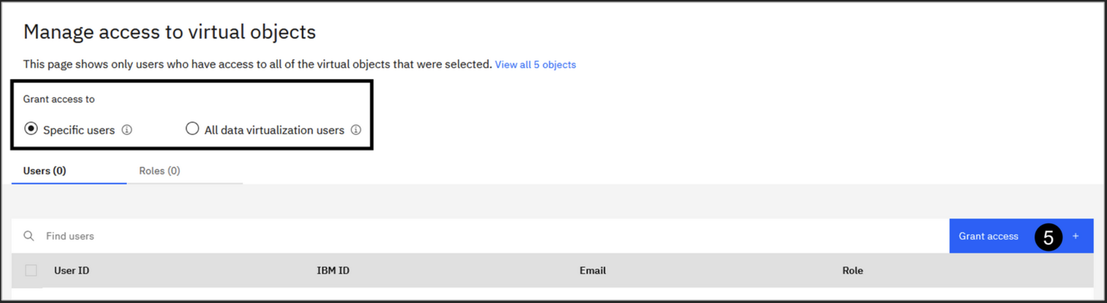
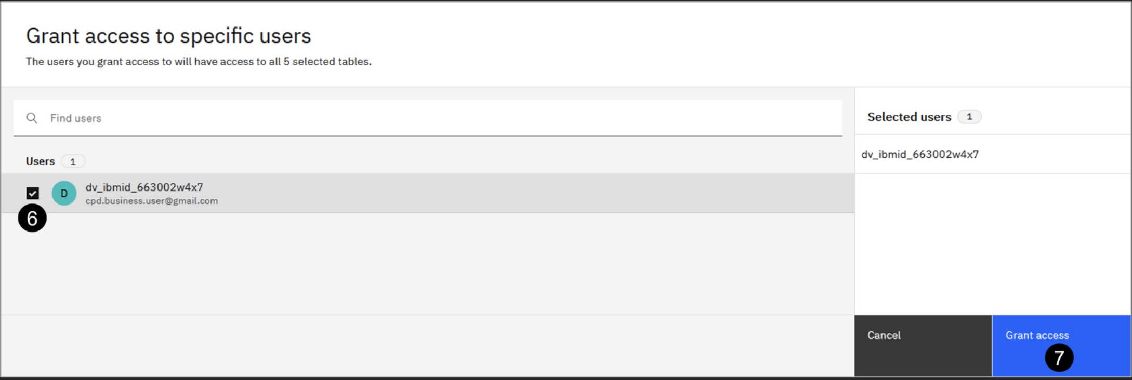
Manage access
You have the option of granting access to a select set of users or to all of Watson Query's data virtualization users (think of this like the PUBLIC role in many relational database systems). Instead, you will selectively only give the business user access to your virtual objects.
Click Grant access + on the right.

Slide 49
Manage access
Check the box for the business user (dv_ibmid_663002w4x7 / cpd.business.user@gmail.com) (which is the user you want to grant access to).
Click Grant access. Wait for this to complete.
The business user has now been granted access to all of your virtual objects. But how exactly does this user go about accessing these objects and using them? That's covered in the next section.

Slide 50
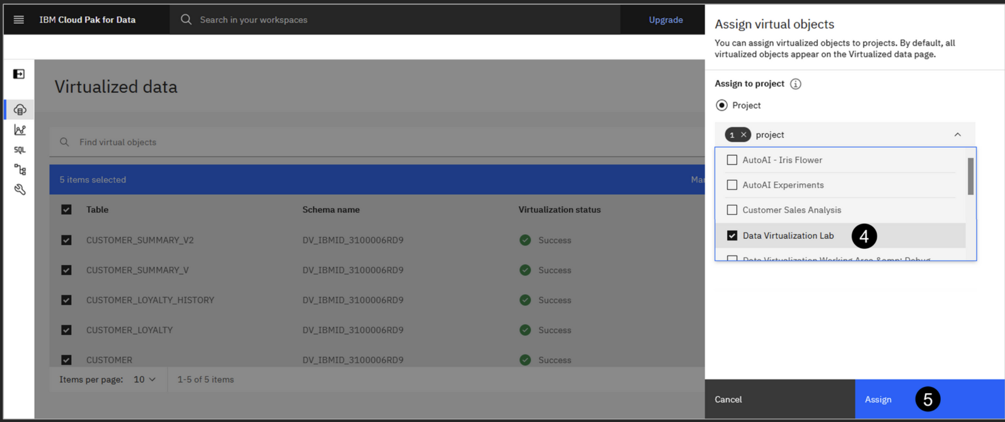
Assigning virtual objects to projects
Select Virtualization > Virtualized data from the side menu.
Check the box beside each of the objects in the table (or check the box in the table header to select all of them at once).
Click Assign on the right
In the Select a project dropdown menu, select the Data Virtualization Lab project you created earlier.
Click the Assign button. You will be returned to the Virtualized data screen.

Slide 51
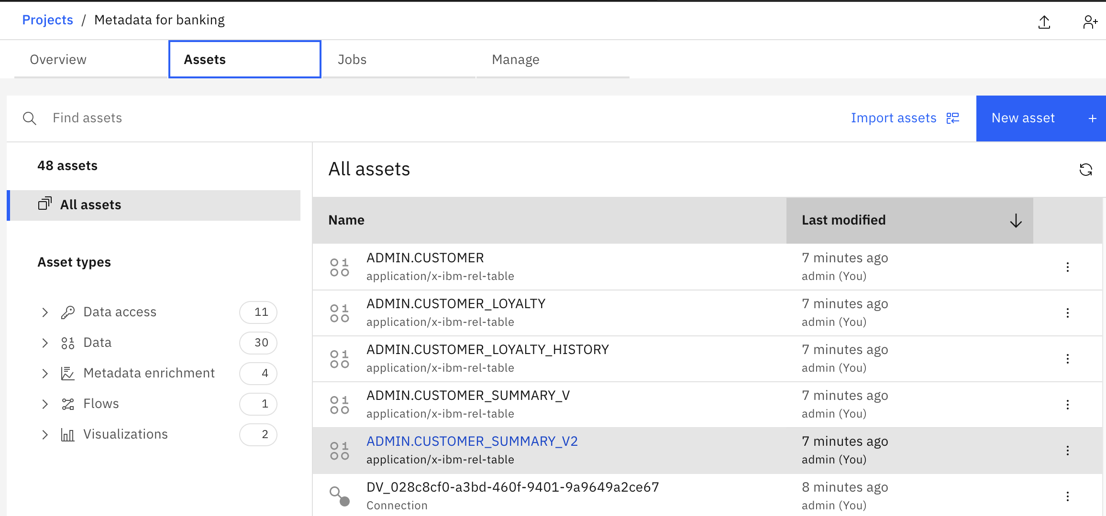
Assigning virtual objects to projects
You may see a green pop-up message stating that the job assigning the virtual view to your project was submitted successfully. Click the X at the right side of the message to dismiss it.
You will now go to the project to see the objects you just assigned to it.
Go to project – ‘Data Virtualization Lab’
Click the Navigation menu in the top left corner.
Select Projects > View all projects.
Click the Data Virtualization Lab project name.
In your project, select the Assets tab.
Select All assets on the left (if not already selected).
Here you should see the five virtual objects assigned to your project, as well as a Connection asset that was created for you automatically (in addition to the notebook you created in the project earlier). You may be wondering what that connection asset is used for. Read on.

Slide 52
Connecting to Virtual Objects
Connection details:
Host name:
pre704d8-3b32-4dd6-a078-1b2e7b4f54a9.bvvoudvd0ef5d9r5df20.databases.appdomain.cloud
Port number:
31266
Database name:
bludb
User ID:
dv_ibmid_270006g705

Slide 53
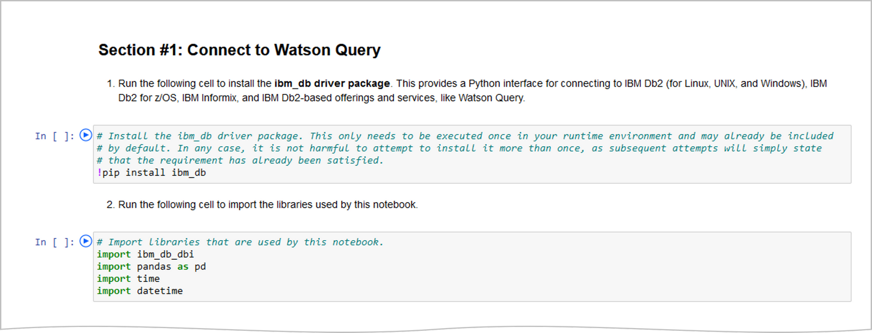
Data Virtualization
With respect to the contents of this notebook, Section #1 includes cells with code to import needed Python libraries, setup connection variables, connect to Watson Query, and run a query to verify the connection was successful

Slide 54
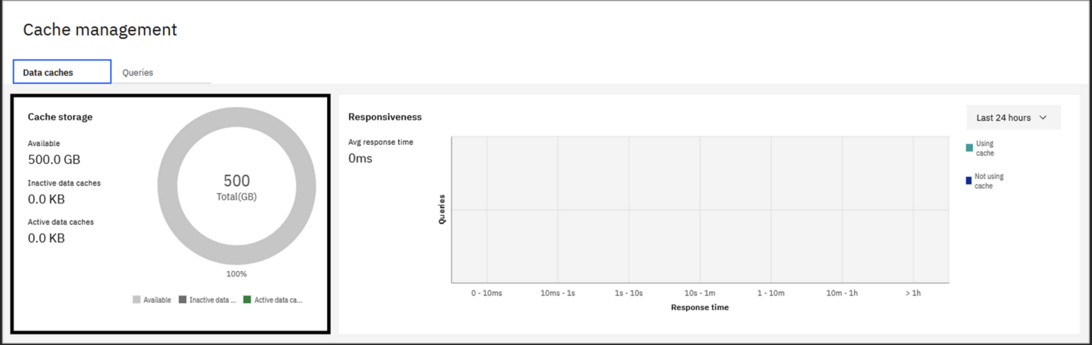
Data Caching
The primary capability of data virtualization in Watson Query is to virtualize data sources so that data can remain in-place while it is accessed through a single framework. However, as a way to improve query performance, a cache can be created locally to store query results. When subsequent queries are executed, the query engine will automatically determine whether data can be served from a cache rather than the base data source(s), resulting in improved query performance. In fact, Watson Query can recommend caches that would improve query performance, and even write the SQL to create them, based on query history. Caches can be refreshed frequently (every hour, for example) to ensure the cached data remains current.
Open a new browser window and log in to Cloud Pak for Data as a Service.
Click the Navigation (hamburger) icon in the upper-left corner and select Data > Data virtualization.
Select Virtualization > Cache management from the side menu. This option is only visible to users with the Manager role, which you have.

Slide 55
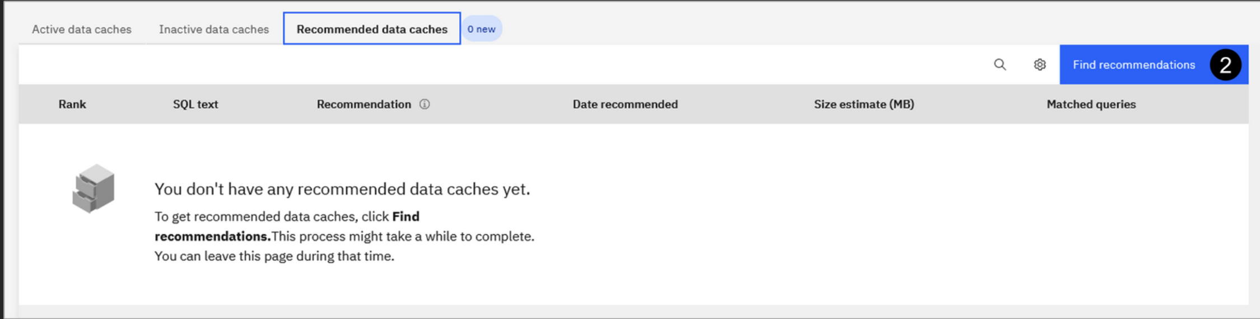
Data Caching
On the Cache management page you can create and manage data caches, as well as monitor the storage utilization and responsiveness of your caches.
Cache storage information is visible in the upper-left portion of the screen. This includes the amount of storage used for both active and inactive caches. Query optimization considers only active caches for improving the performance of queries. Inactive caches are caches that have been deactivated and can't be used for query optimization.
The upper-right portion of the screen shows query responsiveness. Here you can monitor how many queries ran in a specific execution time period. You can also compare the responsiveness of queries that use data caches and queries that do not use data caches.
Active data caches can be viewed and managed in the Active data caches tab at the bottom of the screen. Caches that have been deactivated are listed in the Inactive data caches tab. Cache recommendations made by Watson Query can be found in the Recommended data caches tab.
Select the Recommended data caches tab.

Slide 56
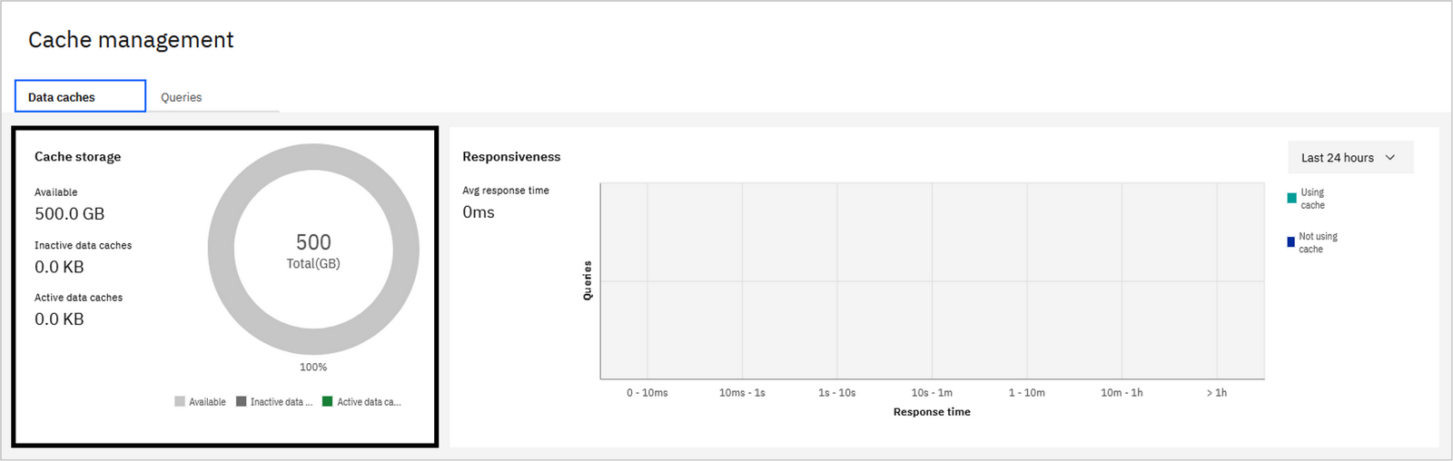
Intelligent caching
To improve query performance:
- Cache can be created locally to store query results. - query engine will automatically determine whether data can be served from a cache rather than the base data source(s), resulting in improved query performance. - Watson Query can recommend caches that would improve query performance, and even write the SQL to create them, based on query history. - Caches can be refreshed frequently (every hour, for example) to ensure the cached data remains current. - On the Cache management page you can create and manage data caches, as well as monitor the storage utilization and responsiveness of your caches. - Cache storage information is visible in the upper-left portion of the screen. This includes the amount of storage used for both active and inactive caches. Query optimization considers only active caches for improving the performance of queries. Inactive caches are caches that have been deactivated and can't be used for query optimization.

Slide 57
Cache Management
The upper-right portion of the screen shows query responsiveness. Here you can monitor how many queries ran in a specific execution time period. You can also compare the responsiveness of queries that use data caches and queries that do not use data caches.
Active data caches can be viewed and managed in the Active data caches tab at the bottom of the screen. Caches that have been deactivated are listed in the Inactive data caches tab. Cache recommendations made by Watson Query can be found in the Recommended data caches tab.
Select the Recommended data caches tab.
Click the Find recommendations button.
When warned that new recommendations will replace existing recommendations, click Continue.
The cache recommendation engine uses two models to generate recommendations. The rule-based model uses sophisticated heuristics to determine which cache candidates help the input query workload. The machine learning-based model uses a pre-trained machine learning model that detects underlying query patterns and predicts caches that could help a potential future query workload.
The cache recommendation engine uses two models to generate recommendations. The rule-based model uses sophisticated heuristics to determine which cache candidates help the input query workload. The machine learning-based model uses a pre-trained machine learning model that detects underlying query patterns and predicts caches that could help a potential future query workload.
Both models produce a ranked list of cache candidates that are consolidated by the engine to generate a final set of recommendations.
In addition to cache creation recommendations, the engine may also recommend disabling and deleting caches based on past usage and other metrics. These recommendations appear in the active and inactive caches tabs for existing caches.
The recommendation engine works in the background, allowing you to navigate to another screen and come back later. However, because you haven't executed a query workload yet, there are not enough input queries to analyze and make recommendations from. Therefore, the recommendation table is likely to be empty at this point.
Let's run a query workload so that actual recommendations can be made..

Slide 58
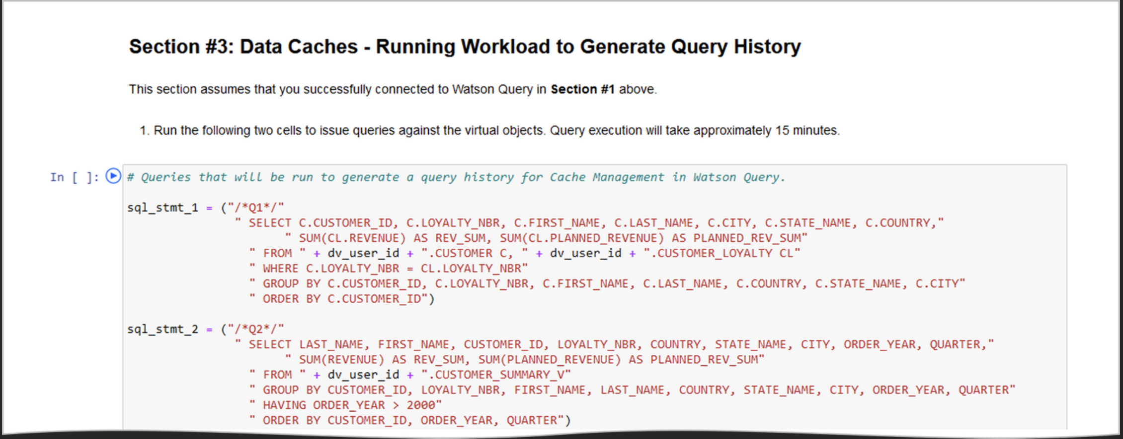
Run Query workload
You will now run a query workload against Watson Query using the same Jupyter notebook you used earlier. Recall that you previously completed the work in Section 1 and Section 2 and your notebook still has a connection to the Watson Query service:
Switch to the browser window where you currently have the Data Virtualization Lab Notebook running.

Slide 59
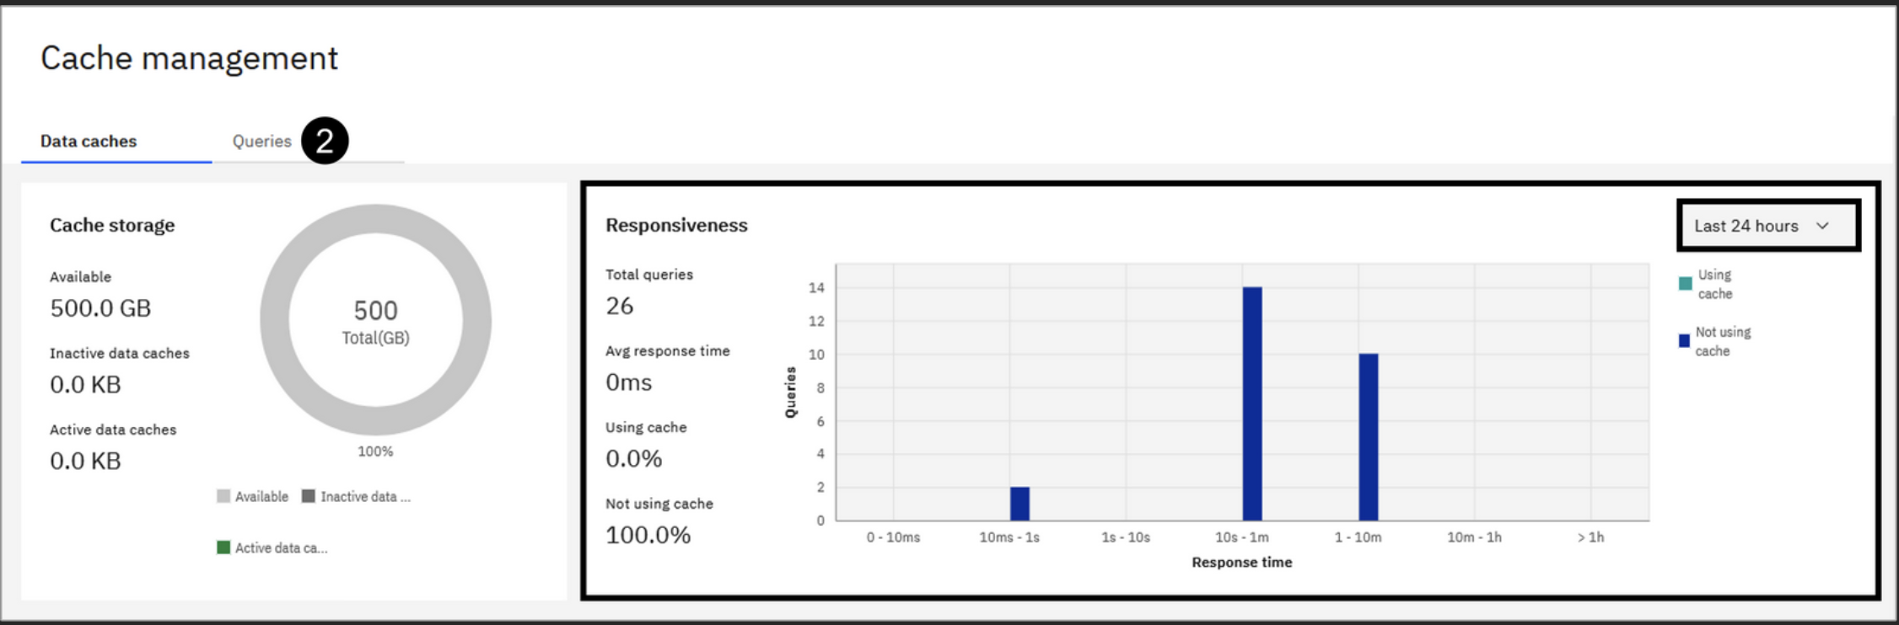
Run Query workload
Follow the instructions in Section #3 to run a series of complex queries against your virtual objects.
Once all of the queries have finished running, wait at least five minutes before proceeding. This should allow the captured queries to be pulled into Watson Query's metastore (which is where the cache management panel and the recommendation engine get query information). The default collection interval time is five minutes.
You no longer require this notebook after this point and can close the browser window (or tab) if you like.
Generate Cache Recommendations
Now that you've issued a number of queries against Watson Query, check to see if there are any data cache recommendations based on that workload.
Select Virtualization > Cache management from the side menu.

Slide 60
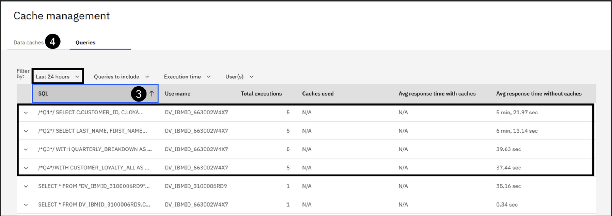
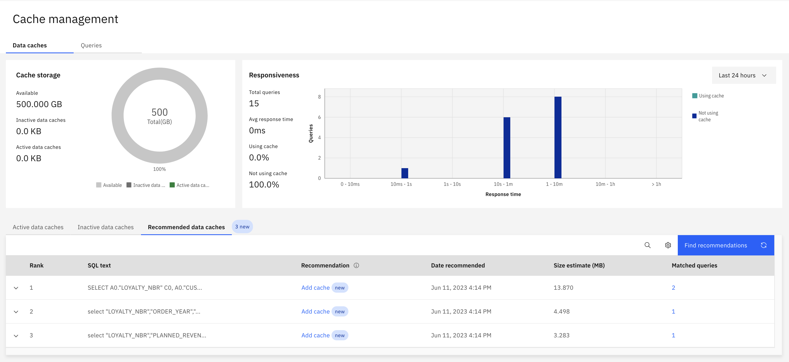
Run Query workload
Select the Queries tab.
Click the SQL header once to sort the list.
The queries you ran in the Jupyter notebook should all be listed, along with the number of times each query was executed and the average response time. You should see queries with /*Q1*/, /*Q2*/, /*Q3*/, and /*Q4*/ in the SQL text, with five total executions each. If you do not see this, or you only see a portion of the statement executions, then the query details haven't been fully extracted into Watson Query's metastore yet. As suggested above, wait a few minutes and refresh the page (similarly, you can toggle the table filter between Last 7 days and Last 24 hours).
Select the Data caches tab.

Slide 61
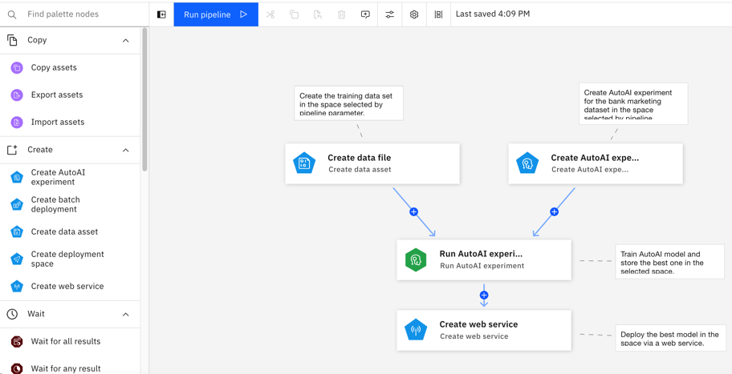
Integration Capabilities - Pipelines
Spark and APIs allow integration to external systems, with support for batch, sync API calls; async APIs can be coded
Watson Pipelines can generate data files in different formats such as text, CSV, XML
Scheduler for batch jobs – no developer effort required - recurring on date/time/cycle
- predefined triggers
- dependencies on other jobs
Kafka connection supported

Slide 62
B1.2.19: Integration Capabilities – others (Application Performance Management)
Red Hat OpenShift supports industry standard based Application Performance Management and integration with common 3rd party APM tools
CA Application Performance Management (CA APM) for OpenShift
The AppDynamics OpenShift JBoss Cartridge Extension provides the ability to monitor and manage your critical cloud-based applications
The ITRS Geneos Kubernetes Collection Agent plugin collects logs, metrics, and events from OpenShift and Kubernetes
In addition, individual metrics and alerts from the various IBM Cloud Pak for Data Services such as Watson OpenScale for Model Performance, Bias and Fairness are also available through APIs, which will need to be integrated with APM tools through a services engagement

Slide 63
Data Sources (cont)
The solution also allows for importing Files into Projects which are managed within the Platform
Option | Implementation details | When to use
Import files into project | Files are copied into a project and stored in the storage component of the CPD cluster | Small to medium files (low GB), not used in multiple projects
Catalog | Files are added to the project from a catalog, same implementation as import files into a project | As a starting point and a final result of use case implementation in Watson Studio
Storage volumes | Configure connections to directories or to specific files, files are loaded at runtime | When it’s the preferred option for storing files, when working with large files, files that change often
Other connection types | Supported connection types (HDFS, Cloud Storage) or access via API in Python/R | When it’s the preferred option for storing/accessing files

Slide 64
Integration with Delivery Systems - IBM Watson Machine Learning
Deployment spaces contain deployable assets, deployments, deployment jobs, associated input and output data, and the associated environments:
With Watson Machine Learning Deployment spaces, you can export assets to downstream systems:
Models
Functions
Pipelines
Scripts
Data assets
Jobs
This can support many file formats.

Slide 65
CP4D Administration and Audit Trail
17
Monitoring of resources like CPU and Memory (capacity utlization) and generation of alerts
Tracking of actions by users
Multitenancy
LDAP Integration: AAD/Kerberos
Restart services
API documentation
Backup (housekeeping)

Slide 66
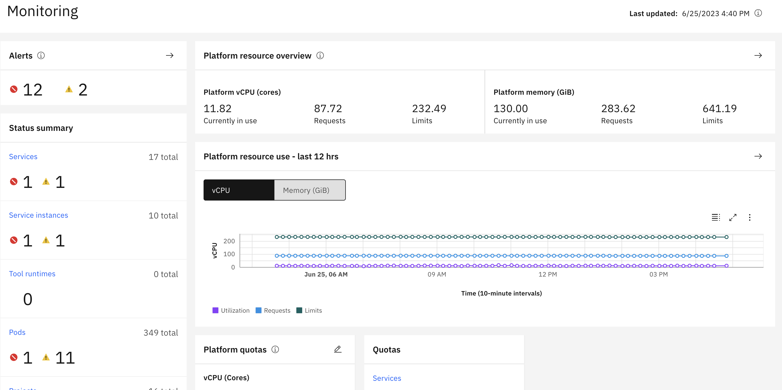
B1.6.6: Monitoring of resources like CPU and Memory (capacity utilization) and generation of alerts

Slide 67
B1.6.6: Monitoring of resources like CPU and Memory (capacity utilization) and generation of alerts
Monitoring the platform
From the IBM Cloud Pak® for Data web client, you can monitor the services that are running on the platform, understand how you are using cluster resources, and be aware of issues as they arise. You can also set quotas on the platform, individual services, and on projects to help mitigate unexpected spikes in resource use.
Accessing the Monitoring page
Required permissions: To access the Monitoring page, you must have one of the following permissions: Administer platform
Manage platform health
View platform health (read-only access)
To access the Monitoring page: Log in to the Cloud Pak for Data web client.
From the navigation menu, select Administration > Monitoring.
From the Monitoring page, you can: See the current resource use (vCPU and memory) for the platformIf you click View status and use data on the Platform resource overview card, you can see a breakdown by services, service instances, projects, environments, and pods.
Review the platform resource use for the last 12 hoursIf you click View historical data on the Platform resource use card, you can see a breakdown by services, service instances, environments, and pods. You can also view historical data beyond 12 hours. By default, the platform stores up to 30 days of data. However, you can adjust the length of time that data is retained. For details, see Changing the retention period for monitoring data.

Slide 68
B1.2.1: List of interfaces methods the platform can ingest data from external system, e.g. batch, sync API call, async APIs via streaming
Spark and APIs allow integration to external systems, with support for batch, sync API calls; async APIs can be coded
Watson Pipelines can generate data files in different formats such as text, CSV, XML
Scheduler for batch jobs – no developer effort required - recurring on date/time/cycle
- predefined triggers
- dependencies on other jobs
Kafka connection supported

Slide 69
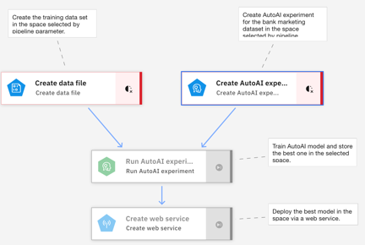
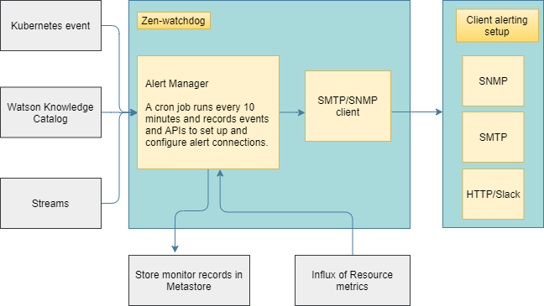
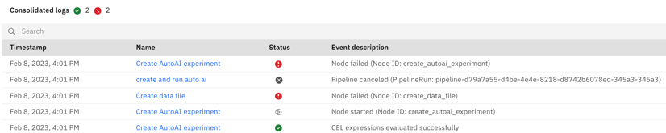
B1.6.1, B1.6.4, Logging, Monitoring & Alerting - Jobs
Ability to alert on job failures with detailed reason notes on failures
Alerts on job failures for various services in CP4D is accomplished through Watson pipelines job logs. Job success notifications can be sent via email
Monitoring the state of the platform can also be configured and events set up to alert when action is needed, based on thresholds that defined.
E.g. monitor the status of pods, check persistent volume claims, quotas for services, service status. The severity of an event can be: critical, warning, or info. Each type of event includes metadata for the event, including a description and steps to resolve the event.

Slide 70
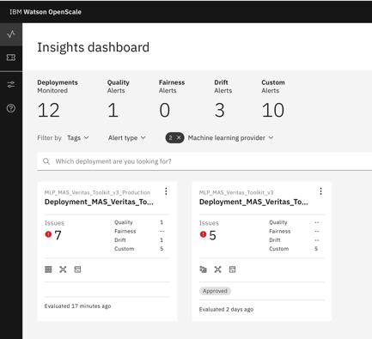
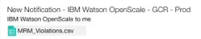
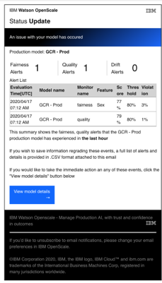
B1.6.2: Logging, Monitoring & Alerting (cont) – Model Endpoints
Ability to alert when API invocation failure exceeding certain predefined SLAs
Assuming pre-defined SLAs are referring to drift, fairness, performance metrics, alerts can be raised when there are SLA breaches during scoring APIs by IBM Watson OpenScale.
Watson OpenScale can be configured to alert users to threshold violations via email
Cloud Pak for Data can send notifications to specific users when the monitoring and alerting framework issues an alert.
Watson OpenScale
Alerts can be raised for Drift, Fairness, & Performance metrics breaching SLAs
Email notification from Watson OpenScale when alert is raised.

Slide 71
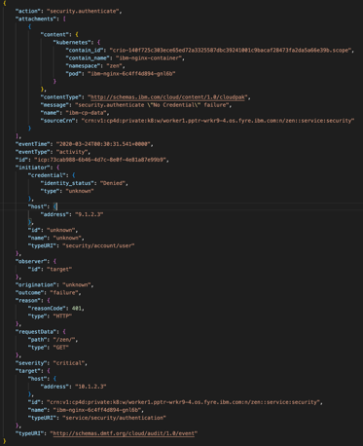
B1.6.7: Audit Trail – Platform Audit Events
Cloud Pak for Data Platform Events:
Login, Logout, Session, Authentication
security.users.authenticate - Success or failure when a user logs in.
security.users.revoke - Record when users log out.
security.accounts.authenticate - Success or failure of token authentication.
security.authorization - Failure when invoking any privileged action.
User Management
users.user.create - Authorize a user for access to the platform.
users.user.delete - Remove access to the platform for user.
users.user.update - Make changes in a user's profile, including name, email address.
users.role.add - Grant a specific privilege to a user on the platform.
users.role.remove - Revoke a platform privilege from a user.
Service Level
services.service.create - A service is installed and enabled.
services.service.delete - A service is uninstalled.
services.service.update - A service is updated.
Service Instances
service_instances.instance.create - A service instance is provisioned.
service_instances.instance.delete - A service instance is unprovisioned.
service_instances.instance.update - A service instance is changed.
service_instances.read - The list of service instances is retrieved.
service_instances.instance.read - A query for the details of a service instance by ID.
service_instances.user.add - Grant user access, with a particular role, to a service instance.
service_instances.user.delete - Revoke user access from a service instance.
service_instances.user.get - A query to list users with access to a service instance.
service_instances.user.update - Change a user’s access role for a service instance.
Connections
connections.create - Add connection.
connections.update – Update connection.
connections.delete – Delete connection.
connections.read – A query issued to retrieve all connections.
connections.connection.read – A query issued to retrieve one connection’s details by ID.
Deployments
deployments.delete - Delete service deployment.
deployments.read – Retrieve service deployment by ID.
Failed Authentication Log

Slide 72
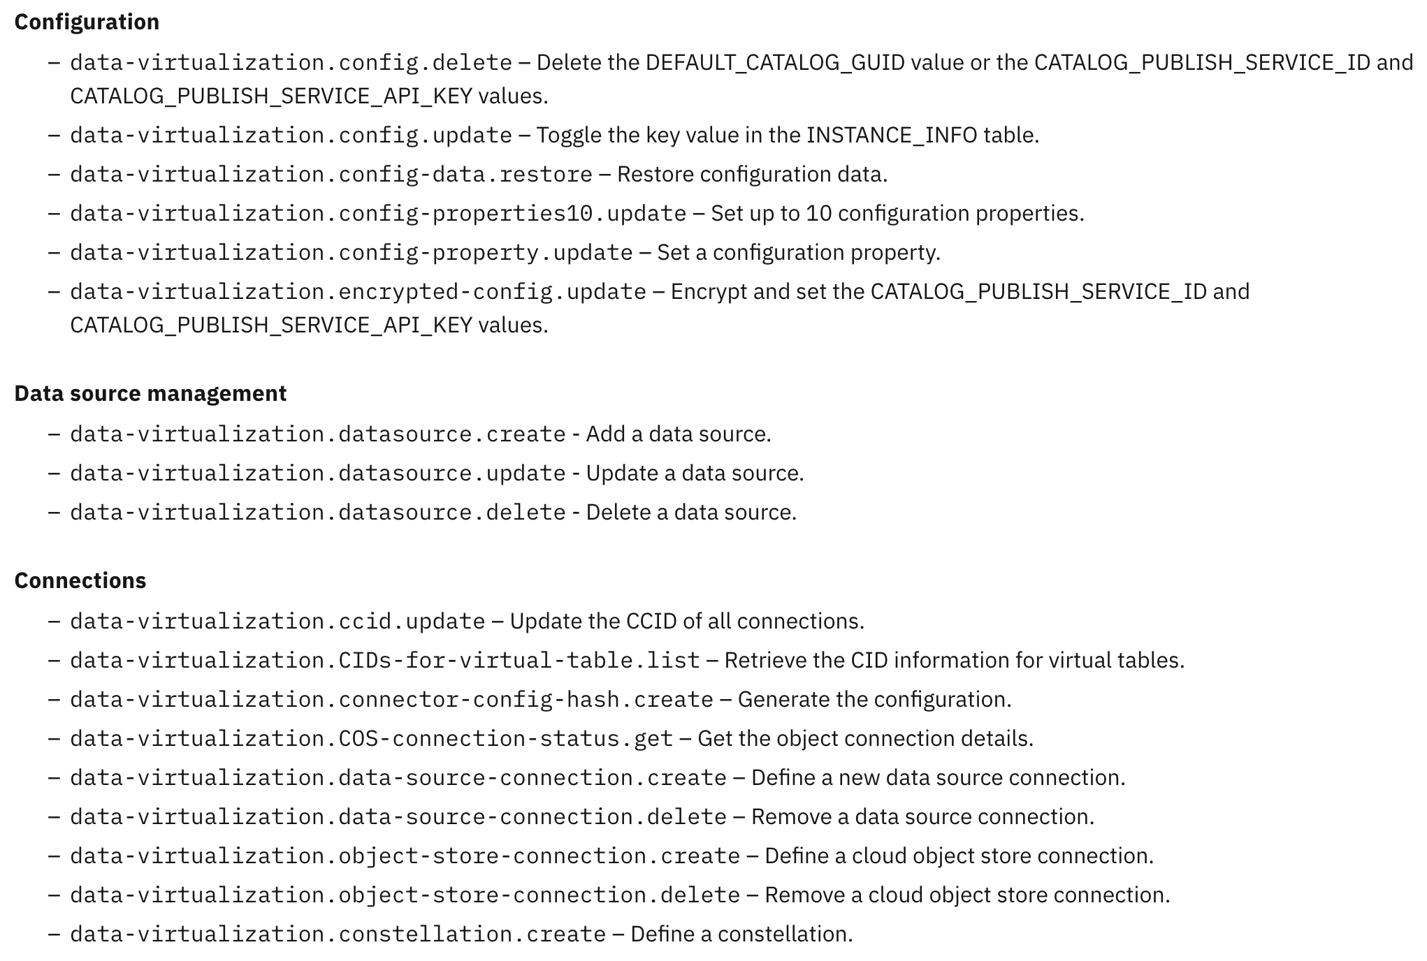
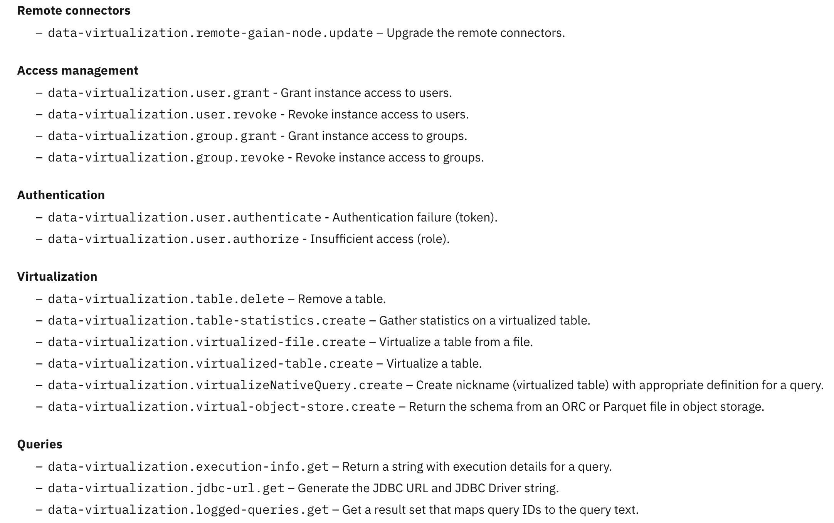
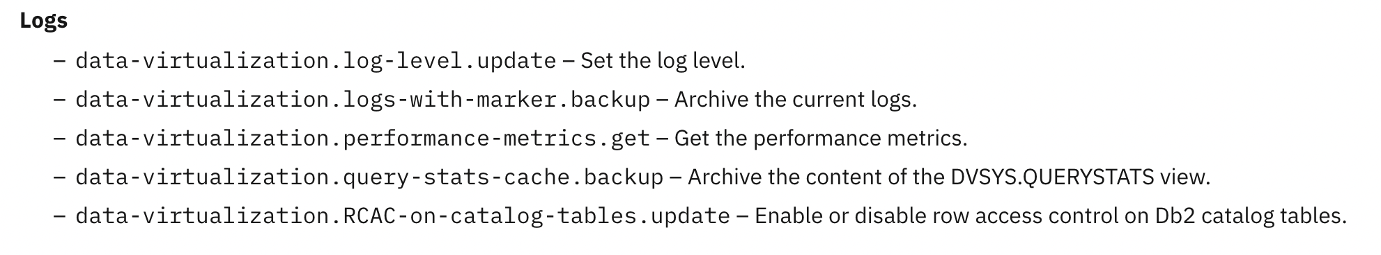
B1.6.7: Audit Trail – Cloud Pak for Data Services Events
Audit events for Cloud Pak for Data Services ( Example: Watson Query)

Slide 73
B1.6.8 Audit Trail
The OpenShift Audit Log and IBM Cloud Pak for Data Audit Logging Service are designed to collect and forward audit records explicitly generated by OpenShift/Kubernetes and IBM Cloud Pak for Data services respectfully. Both Audit Logging solutions can be configured by customers to forward those audit records onto external customer SIEM (Security Information and Event Management) solutions which persists, secures and enables auditing compliance queries.
How can I access audit logs?
You can configure Cloud Pak for Data to forward audit events to:
Splunk
QRadar®
LogDNA
zen-audit pod stdout logs
What events are audited?
Cloud Pak for Data platform audit events The following list describes events in the Cloud Pak for Data platform that are audited.
AI Factsheets The list of events in the AI Factsheets service that are audited.
Db2 Big SQL The list of events in the Db2® Big SQL service that are audited.
Db2 Management Console The list of events in the Db2 Data Management Console service that are audited.
Decision Optimization The list of events in the Decision Optimization service that are audited.
IBM Match 360 with Watson The list of events in the IBM® Match 360 with Watson™ service that are audited.
Informix The list of events in the Informix® service that are audited.
Watson Knowledge Catalog The list of events in the Watson Knowledge Catalog service that are audited.
Watson Query The list of events in the Watson Query service that are audited.
Watson Speech services The list of events in the Watson Speech services that are audited.

Slide 74
B1.6.7, B1.6.8: Logging, Monitoring & Alerting (cont) – User Actions
Audit logging of user actions
Login, Logout, Session, Authentication - Success or failure when a user logs in - Record when users log out - Success or failure of token authentication - Failure when invoking any privileged action
User Management - Authorize a user for access to the platform - Remove access to the platform for user - Make changes in a user's profile, including name, email address - Grant a specific privilege to a user on the platform - Revoke a platform privilege from a user
Service Level
A service is installed and enabled. - A service is uninstalled. - A service is updated.
Service Instances - Service instance provisioned/de-provisioned/ changed - Retrieve list of instances, query for details, list users - Grant/revoke user access to a service instance - Change user’s access role to a service instance
Connections - Add/update/delete connections - Retrieve all connections/connection details by id
Deployments - Read Deployments - Delete Deployments
Audit records can be forwarded to a security information and event management (SIEM) solution, such as Splunk, LogDNA, or QRadar.

Slide 75
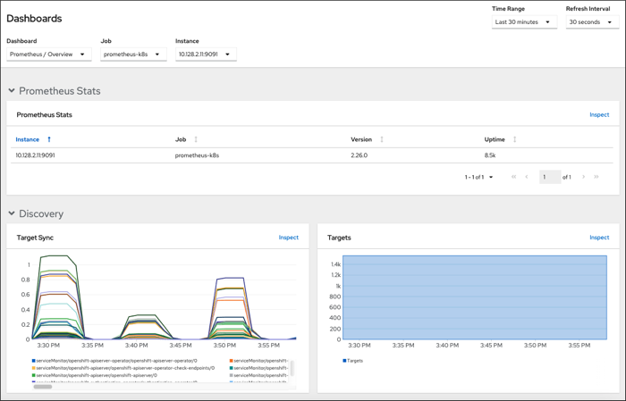
B1.6.6: Logging, Monitoring & Alerting (cont) – Infrastructure
Ability to monitor and review capacity utilization
Ability to support system monitoring, reporting and generation of notification and alerts.
The proposed solution can monitor capacity utilization and is configurable to generate alerts depending on pre-defined thresholds of resource utilization with OpenShift Monitoring Dashboards.
Use the Administrator perspective to access dashboards for the core OpenShift Container Platform components, including the following items:
API performance
etcd
Kubernetes compute resources
Kubernetes network resources
Prometheus
USE method dashboards relating to cluster and node performance
Example dashboard in the Administrator perspective

Slide 76
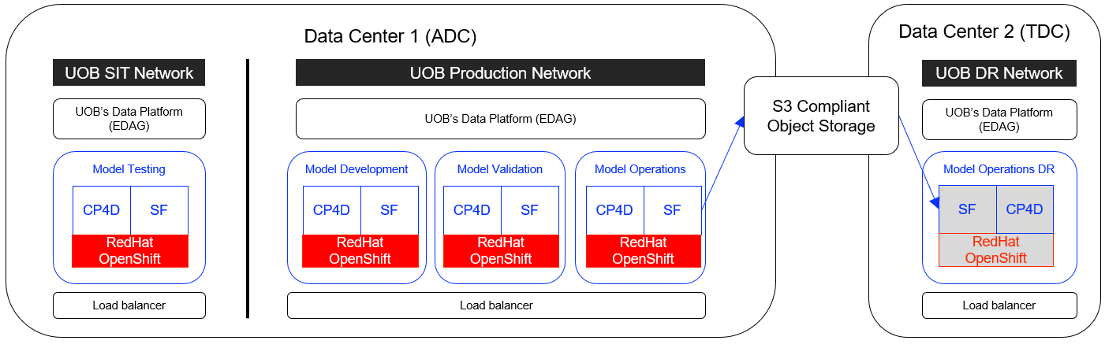
B1.10.d : Non-Functional Architecture (High Availability, DR, Backup / Restore)
The solution comes out of the box with HA, DR and Backup/Restore capabilities as explained below
Spectrum Fusion* backup and restore
UOB Provided Object Storage accessible across Production and DR Networks
Models Deployed through CI/CD Pipeline
The proposed solution, based on IBM Cloud Pak for Data (CP4D) Services, are highly available (HA) leveraging the Microservices architecture on top of RedHat OpenShift
The proposed solution has inbuilt capability for backing up and restoring the solution based on a scheduled basis based on IBM Spectrum Fusion (SF). The backups are stored in UOB provided Object Storage
SF can restore CP4D on to a remote cluster based on the last backup (RPO) to meet the RTO requirements of 48 hours. Based on the DR requirements, the proposal provides a Cold Instance to save on license cost
*Product renamed to IBM Storage Fusion
Notes:
https://www.ibm.com/support/pages/node/1087149

Slide 77

B1.7.1: Application Security - Authentication
User Authentication
Ability to support authentication using Bank's Active Directory for user creation, maintenance, and housekeeping of users
API Support to map users with Application Groups/Roles to integrate with Bank's identity and access management platform (IDM Plus)
The proposed solution can be configured to integrate with Bank's active directory (AD).
Includes Identity and Access Management Service (IAM Service) which can be used to support multiple AD domains.
Provides authentication support via the OpenID Connect (OIDC) specification. Security Assertion Markup Language (SAML)-based federated authentication is also supported.

Slide 78
Application Security (Role Based Access Control – Service Level)
Service level roles define what a user can do inside a particular service:
Role | Description
Viewer | See the list of connections in the platform assets catalog. If a user has the appropriate credentials to access the underlying data source, the user can use the connection to connect to the data source.
Editor | See the list of connections in the platform assets catalog. Create, edit, and delete connections. The Editor must be an asset member.
Admin | See the list of connections in the platform assets catalog. Create, edit, and delete connections. The Editor must be an asset member. Manage the collaborators on the catalog When the catalog is created, any user with the Administrator role in Cloud Pak for Data is assigned the Admin role on the Platform assets catalog.
Applies to:
Projects (Watson Studio)
Deployment Space (Watson Machine Learning)
Catalogs (Watson Knowledge Catalog)
Watson OpenScale
Other services which also utilize service instances.

Slide 79
B1.10 IT usability
Restart services & servers | You can stop, start, restart, and unpause virtual machines from the OpenShift web console or via scripts.
Audit reports | OpenShift Container Platform auditing provides a security-relevant chronological set of records documenting the sequence of activities that have affected the system by individual users, administrators, or other components of the system
Archival and housekeeping | You can create online backups of IBM Cloud Pak for Data instance and restore a backup to the same cluster or to a different cluster to for archival and housekeeping purposes.
Monitoring e.g. by user, user group, task, process, session, CPU/memory/storage utilization (and corresponding alerts and notifications) | Monitoring and alerting framework can be used to monitor the state of the platform and set up events to alert when action is needed, based on thresholds defined. E.g. monitor the status of pods, check persistent volume claims, quotas for services, service status. For users,
Ability to natively support internationalization including full support for international character sets | Besides English, several languages are supported including Brazilian, Chinese (simplified and traditional), French, German, Italian, Japanese, Korean, Russian and Spanish.
Allow administrators of different countries to manage his/her own country end-users in a shared distributed environment | Through creating country specific Catalogs, Cloud Pak for Data can allow administrators of different countries to manage his/her own country end-users in a shared distributed environment
Housekeep logs & temp files, retention period | IBM Cloud Pak for Data monitoring data is stored in an embedded InfluxDB database. By default, the data is retained for 30 days. You can increase the retention period to store additional data or decrease the retention period if you need to reduce the size of the database.

Slide 80
B1.1.12 : Support for Multi-tenancy
Multi-tenancy boils down to the definition of a tenant and the level of isolation required between the tenants.
One scenario is for SaaS type use cases where tenants could be separate customers and complete logical isolation based on resources, management and security is needed – Platform level Multi-tenancy
Other scenario is for Enterprises where tenants are LOBs or Countries and level of isolation across all the services doesn’t need to be entirely logically separate. Where some services can offer the level of isolation like Platform level Multi-tenancy while for others, it can be based on Access Control – Service level Multi-tenancy
Suggested for the Proposal - Service level Multi-tenancy
Multi-tenant Services (Resource level Isolation)
MY - Namespace
SG - Namespace
…
Project
Deployment Space
Project
Deployment Space
Shared Namespace (Access Control based Isolation)
WKC
WSL
SPSS
Analytics Dashboard
Open Pages
…
Cloud Pak For Data Operators
Cloud Pak For Data Foundation Services
Red Hat OpenShift Container Platform
VMWare ESXi (x86)

Slide 81
B1.2.11 & B1.2.12: Provide documents for APIs available on the platform out-of-box– REST APIs
The IBM Cloud Pak for Data platform API is an administration API that you can use to perform the following tasks:
Authenticate to the platform.
Manage the users who have access to the platform.
Manage the roles that are defined on the platform.
Update your user account on the platform.
Monitor the status of the IBM Cloud Pak for Data platform.
Services in IBM Cloud Pak for Data have their own APIs
Refer to the API documentation
Monitoring console allows viewing API activity in the UI to assist in monitoring and troubleshooting
Kafka connection supported
Can import other vendors’ models using PMML
AI Factsheets - control model tracking, retrieve the model facts and get talerts information on the deployed tracked models.
OpenPages - access to OpenPages data and metadata
Watson Data APIs - manage data-related assets and the people who need to use these assets
Watson Machine Learning APIs - train, store, deploy, and score models and functions
Watson OpenScale APIs - measure outcomes, ensure fairness and explainabiity
Watson Pipelines APIs & SDKs - query data, expose outputs, and more

Slide 82
B1.10 (c) Infrastructure – Business Continuity (HA, Backup/Restore and DR Architecture)
The solution comes out of the box with HA, DR and Backup/Restore capabilities as explained below
Spectrum Fusion* backup and restore
UOB Provided Object Storage accessible across Production and DR Networks
Models Deployed through CI/CD Pipeline
The proposed solution, based on IBM Cloud Pak for Data (CP4D) Services, are highly available (HA) leveraging the Microservices architecture on top of RedHat OpenShift
The proposed solution has inbuilt capability for backing up and restoring the solution based on a scheduled basis based on IBM Spectrum Fusion (SF). The backups are stored in UOB provided Object Storage
SF can restore CP4D on to a remote cluster based on the last backup (RPO) to meet the RTO requirements of 48 hours. Based on the DR requirements, the proposal provides a Cold Instance to save on license cost
*Product renamed to IBM Storage Fusion
Notes:
https://www.ibm.com/support/pages/node/1087149

Slide 83


Infrastructure – Business continuity (Storage, Backup, Restore and DR)
IBM Spectrum Fusion*
*Product renamed to IBM Storage Fusion

Slide 84





IBM Spectrum Fusion* – Flexible Deployment Options
IBM Spectrum Fusion
Coming soon!
Google Cloud
IBM Cloud
Bare Metal
*Product renamed to IBM Storage Fusion
Notes:
IBM Storage Fusion is ready now in your data center and for your cloud data and coming soon to be deployed in the cloud including all the major cloud providers.

Slide 85









IBM Spectrum* Fusion Value Proposition
Speed
Get apps from pilot to production faster
Shorten DevOps delivery times
Accelerate time-to-value
Deliver sustained, predictable high performance
Flexibility
Fully (and easily) configurable data services options
Future-proof, infrastructure-agnostic data services
Secure, resilient, plug and play platform
Edge-to-core-to-cloud support
Protection
Integrated Data Protection, High Availability, Metro and Regional Disaster Recovery
Fusion is the ONLY platform that delivers non-disruptive, application-aware, automated backup & recovery for CP4D + new innovation coming in ‘23
Agility/Efficiency
Reduce operational overhead
Self-service storage provisioning
Self-service backup and restore
*Product renamed to IBM Storage Fusion

Slide 86




IBM Spectrum Fusion* – Infrastructure Overview with Storage Fusion
Spectrum Fusion daily backup and restore
UOB provided S3 storage
PVC
OBC
CP4D
Daily Incremental Backup
Self-Service
Storage Provisioning
Backup and restore
User Single sign-on (LDAP)
IBM Spectrum Fusion
ODF
ODF
ODF
Scale out
Master
Master
Master
Worker
Worker
Worker
Scale out
UOB’s Enterprise Systems
LDAP
*Product renamed to IBM Storage Fusion

Slide 87
IBM Spectrum Fusion – Highlights
Simple to deploy, scale and operate
Advanced OpenShift Data Foundation included to provide block, file and object storage for all OpenShift application storage requirements
Self-service provisioning of block, file and object storage
Integrated Storage Fusion data services
Application consistent backup for CP4D
Daily backup and restore to another OpenShift cluster as DR
Application consistent and crash consistent backup for other applications

Slide 88


B1.6.7: Audit Trail – Project Logging
Watson Studio provides audit logging capabilities in the collaboration workspace known as Projects. When creating a project, the project administrator can set the project to log activity. Logs can then be downloaded and exported for analysis (as CSV file).
Tracked activities:
Adding or deleting data assets (of type CSV, XSL and TXT)
Adding, deleting or updating connections (local and global)
Adding data assets added to the project from a catalogue
Adding or deleting Data Refinery flows
Adding or deleting SPSS models
Adding or deleting notebooks
Adding or deleting environment runtime definitions
Adding or deleting notebook or Data Refinery jobs (both on-demand and scheduled jobs)
Updating the project description from the Settings page of the project
Adding or deleting project collaborators
Adding or changing the role of project collaborators
Sample Log:

Slide 89

B1.6.8: Audit Trail – Export Logs
You can configure IBM® Cloud Pak for Data to forward audit records to a security information and event management (SIEM) solution, such as Splunk, LogDNA, or QRadar®.
The Audit Logging Service uses Fluentd output plugins to forward and export audit records.
When you enable the Audit Logging Service, you specify the external SIEM system that you want to forward the audit records to. The Audit Logging Service explicitly supports the following SIEM solutions:
Splunk
LogDNA
QRadar®
Sample integration with Splunk:

Slide 90
Model Environments / Runtimes / Scalability
Environments:
Hybrid Cloud – Cloud native & microservices based, distributed compute, and scaling with OpenShift
Plug and Play with addon services
Multi-tenancy supported at physical and logical levels
Package & library lifecyle management supported through Anaconda Repo
Runtimes:
In-memory computing with – e.g. Spark
Spark Streaming enables scalable, high-throughput, fault-tolerant live data streaming.
Wide variety of language runtimes and packages supported – e.g. Python, R, ONNX, Pandas, Tensorflow
Customizable and extendable – e.g. conda, mamba, pip in notebook/env template
Scalability:
CPD services Size and Auto Scaling
Individual Service and Service Instance Shutdown and Restart
You can adjust IBM Cloud Pak for Data services by scaling the resources that they use to support high availability or to increase processing capacity
scaling out and scaling in automatically-By scaling out and Scaling in automatically resource utilization can be managed for efficiently for Cloud Pak for Data, which can lower the TCO

Slide 91
Create Connections
Log in to the Cloud Pak for Data web client. From the navigation menu,
select Data > Platform connections.
Click New connection. Select the type of data source that you want to connect to.
Enter a name and description for the connection. Enter the details for the connection. The type of connection that you are creating determines the information that you must specify. Typically, a connection requires either:
A hostname and port number
A URL
You might also need to specify the database that you want to connect to.
Enter your credentials for the connection. If prompted, specify whether you want to use personal or shared credentials. You cannot change this option after you create the connection. Personal With personal credentials, each user must specify their own credentials to access the connection. Each user's credentials are saved but are not shared with any other users. Use personal credentials instead of shared credentials to protect credentials. For example, when personal credentials are used, the credentials are invalidated to prevent malicious redirection if another user changes connection properties such as the hostname or port number. Shared With shared credentials, all users access the connection using the same credentials. The default setting is Shared. An administrator can disable shared credentials.
The connection type determines the type of credentials that you must specify. Typically, a connection requires a username and password or an API key and secret key. Some data sources allow you to connect anonymously.
You might need to specify how you want to provide your credentials. The options that are available depend on how the platform is configured.

Slide 92
Role Based Access Control – Authentication & Authorization
Authentication
Identity Providers Integration
Authorization
Roles & Permissions
User Groups & Role based Authorizations

Slide 93
Role Based Access Control – Authentication
Supported mechanisms
via direct LDAP/Active Directory
Web SSO via SAML2
Cloud Pak IAM integration
Typical LDAP Setup:
Configure LDAP
Authorize LDAP users as Cloud Pak for Data users
Authorize LDAP groups

Slide 94

Role Based Access Control – Authentication

Slide 95

Role Based Access Control – Authentication

Slide 96

Role Based Access Control – Authentication

Slide 97
Role Based Access Control – Authorization
Two levels of Authorization :
Global scope
applies across the platform
Resource/Object scoped
For cases where multiple instances of an entity gets created & access needs to be managed per instance: such as databases, projects, catalogs etc.
Access & role in one such Resource does not mean automatic access to another Resource.
For compliance reasons, even “Platform Admins” can be denied access to such a resource (especially to data) - though they can “manage” these entities.

Slide 98
B1.6.7: Audit Trail – Project Logging
Watson Studio provides audit logging capabilities in the collaboration workspace known as Projects. When creating a project, the project administrator can set the project to log activity. Logs can then be downloaded and exported for analysis (as CSV file).
Tracked activities:
Adding or deleting data assets (of type CSV, XSL and TXT)
Adding, deleting or updating connections (local and global)
Adding data assets added to the project from a catalogue
Adding or deleting Data Refinery flows
Adding or deleting SPSS models
Adding or deleting notebooks
Adding or deleting environment runtime definitions
Adding or deleting notebook or Data Refinery jobs (both on-demand and scheduled jobs)
Updating the project description from the Settings page of the project
Adding or deleting project collaborators
Adding or changing the role of project collaborators
Sample Log:

Slide 99
B1.6.8: Audit Trail – Export Logs
You can configure IBM® Cloud Pak for Data to forward audit records to a security information and event management (SIEM) solution, such as Splunk, LogDNA, or QRadar®.
The Audit Logging Service uses Fluentd output plugins to forward and export audit records.
When you enable the Audit Logging Service, you specify the external SIEM system that you want to forward the audit records to. The Audit Logging Service explicitly supports the following SIEM solutions:
Splunk
LogDNA
QRadar®
Sample integration with Splunk:

Slide 100
Model Environments / Runtimes / Scalability
Environments:
Hybrid Cloud – Cloud native & microservices based, distributed compute, and scaling with OpenShift
Plug and Play with addon services
Multi-tenancy supported at physical and logical levels
Package & library lifecyle management supported through Anaconda Repo
Runtimes:
In-memory computing with – e.g. Spark
Spark Streaming enables scalable, high-throughput, fault-tolerant live data streaming.
Wide variety of language runtimes and packages supported – e.g. Python, R, ONNX, Pandas, Tensorflow
Customizable and extendable – e.g. conda, mamba, pip in notebook/env template
Scalability:
CPD services Size and Auto Scaling
Individual Service and Service Instance Shutdown and Restart
You can adjust IBM Cloud Pak for Data services by scaling the resources that they use to support high availability or to increase processing capacity
scaling out and scaling in automatically-By scaling out and Scaling in automatically resource utilization can be managed for efficiently for Cloud Pak for Data, which can lower the TCO

Slide 101



Model Environments / Runtimes / Scalability - Spark environments (Watson Studio)
Environment templates available in Watson Studio for Spark with Python, R and Scala
Notes:
If your notebook includes Spark APIs, or you want to create machine learning models or model flows with Spark runtimes, you need to associate the tool that you are using with a Spark environment. With Spark environments, you can configure the size of the Spark driver, and the size and number of the executors.
You can use the included Spark environment templates to quickly get started with Spark notebooks in Watson Studio tools, without having to create your own environment templates. The included environment templates are listed under Templates on the Environments page on the Manage tab of your project.

Slide 102
Model Environments / Runtimes / Scalability
Environments:
Hybrid Cloud – Cloud native & microservices based, distributed compute, and scaling with OpenShift
Plug and Play with addon services
Multi-tenancy supported at physical and logical levels
Package & library lifecyle management supported through Anaconda Repo
Runtimes:
In-memory computing with – e.g. Spark
Spark Streaming enables scalable, high-throughput, fault-tolerant live data streaming.
Wide variety of language runtimes and packages supported – e.g. Python, R, ONNX, Pandas, Tensorflow
Customizable and extendable – e.g. conda, mamba, pip in notebook/env template
Scalability:
CPD services Size and Auto Scaling
Individual Service and Service Instance Shutdown and Restart
You can adjust IBM Cloud Pak for Data services by scaling the resources that they use to support high availability or to increase processing capacity
scaling out and scaling in automatically-By scaling out and Scaling in automatically resource utilization can be managed for efficiently for Cloud Pak for Data, which can lower the TCO

Slide 103
Model Environments / Runtimes / Scalability - Elasticity and Scalability
Pre-defined Sizes
T-Shirt sizes: “Small”, “Medium”, “Large”
Small typically implies 1 replica for deployments & statefulsets (no HA), Medium - multiple replicas & higher resource requests & limits, Large - for larger workload
(tenant) Admins can decide to change scale as needed (subject to any ResourceQuota cap set by the Cluster Admin for that tenant namespace)
Users launching Data Science environments, Jobs, Auto AI experiments or when provisioning databases etc. can pick a size/scale appropriate for their use case or HA needs
Auto Scaling
OpenShift’s Cluster auto-scaler scales up/down your cluster based on policies and modifies the cluster automatically. It can add Machines/Nodes to the Cluster automatically or scale in as well based on load on the cluster
Scale out with Horizontal Pod AutoScaler (HPA): The HPA changes a deployment or stateful set resource allocation by increasing or decreasing the number of Pod replicas in response to observed CPU or memory consumption. Multiple Services in Cloud Pak for Data v4.6 leverage HPA to granularly scale out micro-services.
Scale up with Vertical pod Auto Scaler (VPA): The VPA automatically computes historic and current CPU and memory usage for the containers in individual pods and uses this data to determine optimized resource limits and requests. Since pods can restart or be recreated when automatically resized, HA configuration is important.
Notes:
All the various services in cloud pak for data like Watson studio, Watson Machine learning, Watson Openscale etc come with various predefined Sizes
Admins can decide to change scale as needed
Users launching Data Science environments, Jobs, Auto AI experiments or when provisioning databases etc. can pick a size/scale appropriate for their use case or HA needs
Auto Scaling
OpenShift’s Cluster auto-scaler scales up/down your cluster based on policies and modifies the cluster automatically. It can add Machines/Nodes to the Cluster automatically or scale in as well based on load on the cluster
Scale out with Horizontal Pod AutoScaler (HPA): The HPA changes a deployment or stateful set resource allocation by increasing or decreasing the number of Pod replicas in response to observed CPU or memory consumption. Multiple Services in Cloud Pak for Data v4.6 leverage HPA to granularly scale out micro-services.
Scale up with Vertical pod Auto Scaler (VPA): The VPA automatically computes historic and current CPU and memory usage for the containers in individual pods and uses this data to determine optimized resource limits and requests. Since pods can restart or be recreated when automatically resized, HA configuration is important.

Slide 104

B1.10 (a) Model Environments / Runtimes / Scalability - Elasticity and Scalability
Individual Service and Service Instance Shutdown and Restart
The ability to manually shutdown Cloud Pak for Data Services and Service Instances when not needed, and then restart them manually when they are needed.
This feature will reduce the overall IPI costs by 'turning off' the services when not needed, which will reduce the usage of CPU and memory resources and inturn lower the overall TCO
No need to uninstall Cloud Pak for Data Services or manually shutdown service pods or microservices

Slide 106

DevOps Architecture
The solution provides out of box integration with Source Repositories such as GitHub, GitHub Enterprise, GitLab, GitLab Self-Managed, BitBucket, BitBucket Enterprise, Azure DevOps Services
Integration with other UOB’s DevOps Toolchain will be via various APIs provided by Cloud Pak for Data

Slide 107
Data Virtualization – Rule created

Slide 108

Data Virtualization -Governance
Data > Data virtualization.
Administration > Service settings
Select Governance tab
Toggle the Enforce policies within Data Virtualization switch to On. Toggle the Enforce publishing to a governed catalog switch to On.

Slide 109

Storage details

Slide 110
Define Data Sources
Select Virtualization > Data sources from the side menu. Click Add connection + in the upper-right corner and then select Existing platform connection.
When prompted with the Confirm to continue pop-up message, click Confirm.
Select the radio button for the Data Warehouse (IBM Db2 Warehouse) connection.
Click Add. Data sources:
Show PostgreSQL Data Source
Show Amazon S3 Data Source
Show constellation view
A remote connector enables the virtualization of data that is stored on a file system or a remote data source that is not directly accessible by Watson Query.

Slide 111
Virtualize data
Rather than you manually searching through the database data source – looking for tables across the many schemas in a Db2 or Oracle database, for instance – it will automatically scan the database (based on the permissions of the user used for the connection) and present the data objects found to you. You can then choose to create virtual tables as needed, based on the objects listed.
Select Virtualization > Virtualize from the side menu. Click list
Hundreds of tables are listed. Where did all these tables come from? Watson Query discovered them from your database connections!
In the Filter by bar, click on the Source type, Database, and Schema dropdown selection menus to get a feel for the type of filtering that can be done.
In the Find tables by name, schema, column, or business term search field, enter CUSTOMER.
Check the boxes for both the CUSTOMER and CUSTOMER_LOYALTY tables.
Note: The auto-discovery operation may take a minute or two to complete and so you might not see both of these tables listed initially. You may also see pop-up messages saying things like "Tables were added or updated. Click Reload to load the tables." and "All listed tables are loaded: Click Refresh to update the list." Click to reload and refresh as needed and both of these tables should eventually show up.
Click Add to cart.
Click View cart (2) (the “2” represents the two tables that you added to the cart) to advance to the Review cart and virtualize tables page.
Watson Query gives clients the flexibility to customize virtual tables based on their needs. For example, on this Review cart and virtualize tables page, you can choose to rename the schema and/or table names, as well as remove columns or change the name and type of columns within the tables. For this lab, leave the schema and table names as they are. The source of the schema name (which is unique to you) will be explained later in the lab.

Slide 112
Virtualize data
CUSTOMER: Main customer details, including name, address, and credit card information. This table is hosted in a Db2 Warehouse relational database.
CUSTOMER_LOYALTY: Customer loyalty and sales information from 2016 onward. This table is hosted in a PostgreSQL relational database.
CUSTOMER_LOYALTY_HISTORY: Archived customer loyalty information from 2010-2015. This data is stored in a CSV file on Amazon S3 object storage.
Select Virtualization > Virtualize from the side menu.
In the Find tables by name, schema, column, or business term search field, enter CUSTOMER.
Check the boxes for both the CUSTOMER and CUSTOMER_LOYALTY tables.
Click Add to cart.
Click View cart (2) (the “2” represents the two tables that you added to the cart) to advance to the Review cart and virtualize tables page.
Within the Objects to be virtualized section, click the vertical ellipsis at the right side of the row for the CUSTOMER table and select Edit columns.
Uncheck the rows associated with the GENDER and EDUCATION columns (these columns were chosen arbitrarily, simply as an example of how to do this).
Click the Apply button in the upper-right corner.
Unselect the Assign to project check box. By doing this, the table won't be added to any project, but it will be available in the Virtualized data section of the console (which you will see later).
Click the Virtualize button in the upper-right corner.
The virtualization process has started for the CUSTOMER and CUSTOMER_LOYALTY tables. Click Virtualize more data.

Slide 113
Virtualizing Data from Object Storage Files
For files located in object storage, you start by selecting the endpoint URL and then work your way through the bucket and any folders as needed to locate the file(s) you want to virtualize as a table in Watson Query.
Select the Files tab.
Click the https://s3.us-east-2.amazonaws.com endpoint URL link
Select the cpd-outcomes-s3 bucket on the left
Select the Customer folder.
Select CUSTOMER_LOYALTY_HISTORY.csv.
Click Add to cart.
Click View cart (1).
Unselect the Assign to project check box. By doing this, the table won't be added to any project, but it will be available in the Virtualized data section of the console (which you will see later).
Change the table name from CUSTOMER_LOYALTY_HISTORY_csv to CUSTOMER_LOYALTY_HISTORY.
Click the vertical ellipsis at the right side of the row for the CUSTOMER_LOYALTY_HISTORY table and select Edit columns.

Slide 114
Virtualizing Data from Object Storage Files
Click the vertical ellipsis at the right side of the row for the CUSTOMER_LOYALTY_HISTORY table and select Edit columns.

Slide 115
Virtualizing Data from Object Storage Files
When profiling the data, three columns may incorrectly be assigned the wrong type. Make the following changes to the columns listed (if they are not already assigned the Int (integer) type):
QUANTITY_SOLD: Change type to INTEGER
SHIPPING_DAYS: Change type to INTEGER
SATISFACTION_RATING: Change type to INTEGER
Scroll up and click the Apply button in the upper-right corner.
Back on the Review cart and virtualize tables screen, click the Virtualize button in the upper-right.
14. The virtualization process has started for the CUSTOMER_LOYALTY_HISTORY table. Click Go to virtualized data.
The three tables are now available for access through Watson Query (and have been published to the catalog). Virtual views can also be created "on top of" the virtual tables.

Slide 116
Create Virtual Views
In Watson Query, there are two options available for creating a view that joins tables (or other views) together. One approach is to use the graphical interface and the other is to create it manually by running a CREATE VIEW SQL statement. The graphical approach is very simple and intuitive, whereas the SQL approach is more flexible. A SQL statement allows for very specific filtering, the ability to join more than two tables at once, and more choices on the type of join used (inner join, left outer join, right outer join, full outer join, and so on).
Check the boxes for both the CUSTOMER and CUSTOMER_LOYALTY tables.
Click Join on the right.
Select the check box in the Column name header for the table on the left (which will select every column in the table).
Select the check box in the Column name header for the table on the right (which will select every column in the table).
Put your cursor focus on the LOYALTY_NBR row in the table on the left and click on it, without releasing the mouse button (nothing will happen yet).
Holding the mouse button down, drag the connection line that appears when you start moving the cursor...
... and connect the line to the LOYALTY_NBR row of the table on the right.
A blue line will appear, connecting these two columns as the join key. Note the key icons that appear – they indicate that the join key is comprised of the LOYALTY_NBR columns in the two tables.

Slide 117
This screen allows you to modify the column names, but don’t modify any of them. Click Next

Slide 118
Create Virtual Views
Unselect the Assign to project check box. By doing this, the view won't be added to any project, but it will be available in the Virtualized data section of the console (which you will see later).
Enter CUSTOMER_SUMMARY_V for the View name. (Duplication checking is performed as you type and if you see a message stating that the view name already exists, finish typing and wait for the message to disappear.)

Slide 119
Create Virtual Views
The view has been created successfully.
Click Go to virtualized data.
You should see the CUSTOMER_SUMMARY_V view in your list of virtualized data objects. Next, you will create a view by specifying a SQL statement.

Slide 120
Create Virtual Views
Note: The order of the two tables that you see might not match the image above (CUSTOMER might be on the left with CUSTOMER_LOYALTY on the right). That is okay as the instructions below still apply.
Like you did earlier, check the boxes for both the CUSTOMER and CUSTOMER_LOYALTY tables.
Click Join on the right.
Select the check box in the Column name header for the table on the left (which will select every column in the table).
Select the check box in the Column name header for the table on the right (which will select every column in the table).
Put your cursor focus on the LOYALTY_NBR row in the table on the left and click on it, without releasing the mouse button (nothing will happen yet).
Holding the mouse button down, drag the connection line that appears when you start moving the cursor...
... and connect the line to the LOYALTY_NBR row of the table on the right.
A blue line will appear, connecting these two columns as the join key. Note the key icons that appear – they indicate that the join key is comprised of the LOYALTY_NBR columns in the two tables.
You are about to provide your own definition for the view, so why do this work to specify the columns to include and the join key here? The console doesn't permit you to click the Open in SQL editor link until you've done this. Generally, you would use this approach to construct the view as much as possible with the graphical interface and then tweak the final definition using the editor.
Click Open in SQL editor.
When warned about returning to the Join virtual objects page after creating the view through SQL, click Continue.
A CREATE VIEW SQL statement is pre-populated in the SQL Editor. The view definition includes the columns you selected from the tables on the previous screen, along with the join key you specified.
At this point you can modify the pre-populated statement or completely replace it with your own statement. If your intention is to create a view that you otherwise could have created using the graphical approach, but there was logic or behavior you couldn’t specify – such as a specific type of join – then you would want to use this combined approach. In that case, do exactly what you did here to specify the columns involved and the join key and then tweak the statement as needed in the SQL Editor before running it.
If you have a CREATE VIEW statement designed already (like in this example) then you also have the option of running it in the Run SQL section of the console (which you will experience later) or using a 3rd party SQL editor connected into the environment.

Slide 121
Create Virtual Views
Replace the pre-populated CREATE VIEW statement with the statement below:
CREATE VIEW CUSTOMER_SUMMARY_V2 AS
SELECT CUSTOMER.CUSTOMER_ID AS CUSTOMER_ID, CUSTOMER.LOYALTY_NBR AS LOYALTY_NBR, CUSTOMER.FIRST_NAME AS FIRST_NAME,
CUSTOMER.LAST_NAME AS LAST_NAME, CUSTOMER.CUSTOMER_NAME AS CUSTOMER_NAME, CUSTOMER.COUNTRY AS COUNTRY,
CUSTOMER.STATE_NAME AS STATE_NAME, CUSTOMER.STATE_CODE AS STATE_CODE, CUSTOMER.CITY AS CITY,
CUSTOMER.LATITUDE AS LATITUDE, CUSTOMER.LONGITUDE AS LONGITUDE, CUSTOMER.POSTAL_CODE AS POSTAL_CODE,
CUSTOMER.LOCATION_CODE AS LOCATION_CODE, CUSTOMER.INCOME AS INCOME, CUSTOMER.MARITAL_STATUS AS MARITAL_STATUS,
CUSTOMER.CREDIT_CARD_TYPE AS CREDIT_CARD_TYPE, CUSTOMER.CREDIT_CARD_NUMBER AS CREDIT_CARD_NUMBER,
CUSTOMER.CREDIT_CARD_CVV AS CREDIT_CARD_CVV, CUSTOMER.CREDIT_CARD_EXPIRY AS CREDIT_CARD_EXPIRY,
CUSTOMER_LOYALTY.ORDER_YEAR AS ORDER_YEAR, CUSTOMER_LOYALTY.QUARTER AS QUARTER,
CUSTOMER_LOYALTY.MONTHS_AS_MEMBER AS MONTHS_AS_MEMBER, CUSTOMER_LOYALTY.LOYALTY_STATUS AS LOYALTY_STATUS,
CUSTOMER_LOYALTY.PRODUCT_LINE AS PRODUCT_LINE, CUSTOMER_LOYALTY.COUPON_RESPONSE AS COUPON_RESPONSE,
CUSTOMER_LOYALTY.COUPON_COUNT AS COUPON_COUNT, CUSTOMER_LOYALTY.QUANTITY_SOLD AS QUANTITY_SOLD,
CUSTOMER_LOYALTY.UNIT_SALE_PRICE AS UNIT_SALE_PRICE, CUSTOMER_LOYALTY.UNIT_COST AS UNIT_COST,
CUSTOMER_LOYALTY.REVENUE AS REVENUE, CUSTOMER_LOYALTY.PLANNED_REVENUE AS PLANNED_REVENUE,
CUSTOMER_LOYALTY.SHIPPING_DAYS AS SHIPPING_DAYS, CUSTOMER_LOYALTY.CUSTOMER_LIFETIME_VALUE AS CUSTOMER_LIFETIME_VALUE,
CUSTOMER_LOYALTY.LOYALTY_COUNT AS LOYALTY_COUNT, CUSTOMER_LOYALTY.BACKORDER_STATUS AS BACKORDER_STATUS,
CUSTOMER_LOYALTY.SATISFACTION_RATING AS SATISFACTION_RATING, CUSTOMER_LOYALTY.SATISFACTION_REASON AS SATISFACTION_REASON
FROM CUSTOMER, CUSTOMER_LOYALTY
WHERE CUSTOMER.LOYALTY_NBR=CUSTOMER_LOYALTY.LOYALTY_NBR;

Slide 122
Create virtual views
Click the Format the statements in the editor (</>) button (in the middle of the tool bar above the SQL statement). This nicely formats the SQL statement.
Click Run all.
Once the view has been created successfully, click the Back button.

Slide 123
Explore virtual view
Click Virtualized data in the breadcrumb at the top of the screen
You should now see both the CUSTOMER_SUMMARY_V and the CUSTOMER_SUMMARY_V2 views in your list of virtualized data objects.

Slide 124
Manage access
Take a closer look at one of the views you just created:
Click the vertical ellipsis at the right side of the row for the CUSTOMER_SUMMARY_V view.
Notice all of the various things you can do with the view, such as viewing details about it (which includes previewing the data), managing access, and publishing the view to a catalog. Select View details to preview the data in the view.
Note: You may need to wait a few seconds for the rows to be displayed. The preview area will remain blank (showing "0 Columns" and "0 Rows") until the rows are loaded.

Slide 125
Manage access
Manage Access
Virtual objects can be accessed by applications through Watson Query. More specifically, an application can connect to Watson Query and issue queries against the objects that the application has access to (based on the user associated with the connection).
There are two levels of access control that need to be managed. First, at the Watson Query level – where users need to be added and assigned roles. Second, at the individual object level – where users are granted access to an object in order to view and query the data associated with it.
1. Select Administration > User management from the side menu. You should start in the Users tab by default.

Slide 126
Manage access
Make note of your user ID as you will need to use it later in this lab. Write it down or copy it into a document.
dv_ibmid_270006g705
There are four roles that can be assigned to users in the Watson Query environment:
Manager: Administrator of the environment and “super user” – able to perform all activities, including adding other users.
Engineer: Configures the data sources, virtualizes data, and manages access to virtual objects. Users with this role can create a virtual table or view and grant access to it to users with the Engineer or User role.
Steward: Can access data in all user tables and views. Unlike users with the Engineer role, a user with the Steward role cannot configure data sources or create virtual tables – but it can create virtual views on top of existing virtual tables and views.
User: Can create views on top of virtual tables and views to which they have been given access.

Slide 127
Manage access
To show the process of adding a regular user and managing access to virtual objects, you are going to add an existing IBM ID to the Watson Query environment. This is a user that was previously created for use within the Data and AI Live Demos environment. This user will be referred to as the business user going forward.
Click Grant access+ on the right.
Select User for the Role.
Click Create. This may take a minute or two to complete. Wait until it completes.
Accessing Virtual Objects:
Generally speaking, by default, virtual objects are only accessible by the user that created them (unless a user has a role that permits access to all of the objects created). Therefore, the customer-related virtual tables and the virtual views that you created earlier in this lab are only accessible by you, and not by the business user you just added. This business user must be explicitly granted access to the virtual objects you created.
Select Virtualization > Virtualized data from the side menu.
Check the box beside each of the objects in the table (or check the box in the table header to select all of them at once).
Click Manage access on the right.
When the Manage access to virtual objects window pops up, click Continue.

Slide 128
Assigning virtual objects to projects
Select Virtualization > Virtualized data from the side menu.
Check the box beside each of the objects in the table (or check the box in the table header to select all of them at once).
Click Assign on the right
In the Select a project dropdown menu, select the Data Virtualization Lab project you created earlier.
Click the Assign button. You will be returned to the Virtualized data screen.

Slide 129
Assigning virtual objects to projects
You may see a green pop-up message stating that the job assigning the virtual view to your project was submitted successfully. Click the X at the right side of the message to dismiss it.
You will now go to the project to see the objects you just assigned to it.
Go to project – ‘metadata for banking’
Click the Navigation menu in the top left corner.
Select Projects > View all projects.
Click the Metadata for banking project name.
In your project, select the Assets tab.
Select All assets on the left (if not already selected).
Here you should see the five virtual objects assigned to your project, as well as a Connection asset that was created for you automatically (in addition to the notebook you created in the project earlier). You may be wondering what that connection asset is used for. Read on.

Slide 130
Data Virtualization
With respect to the contents of this notebook, Section #1 includes cells with code to import needed Python libraries, setup connection variables, connect to Watson Query, and run a query to verify the connection was successful

Slide 131
Data Caching
The primary capability of data virtualization in Watson Query is to virtualize data sources so that data can remain in-place while it is accessed through a single framework. However, as a way to improve query performance, a cache can be created locally to store query results. When subsequent queries are executed, the query engine will automatically determine whether data can be served from a cache rather than the base data source(s), resulting in improved query performance. In fact, Watson Query can recommend caches that would improve query performance, and even write the SQL to create them, based on query history. Caches can be refreshed frequently (every hour, for example) to ensure the cached data remains current.
Open a new browser window and log in to Cloud Pak for Data as a Service.
Click the Navigation (hamburger) icon in the upper-left corner and select Data > Data virtualization.
Select Virtualization > Cache management from the side menu. This option is only visible to users with the Manager role, which you have.

Slide 132
Data Caching
On the Cache management page you can create and manage data caches, as well as monitor the storage utilization and responsiveness of your caches.
Cache storage information is visible in the upper-left portion of the screen. This includes the amount of storage used for both active and inactive caches. Query optimization considers only active caches for improving the performance of queries. Inactive caches are caches that have been deactivated and can't be used for query optimization.
The upper-right portion of the screen shows query responsiveness. Here you can monitor how many queries ran in a specific execution time period. You can also compare the responsiveness of queries that use data caches and queries that do not use data caches.
Active data caches can be viewed and managed in the Active data caches tab at the bottom of the screen. Caches that have been deactivated are listed in the Inactive data caches tab. Cache recommendations made by Watson Query can be found in the Recommended data caches tab.
Select the Recommended data caches tab.

Slide 133
Intelligent caching
To improve query performance:
- Cache can be created locally to store query results. - query engine will automatically determine whether data can be served from a cache rather than the base data source(s), resulting in improved query performance. - Watson Query can recommend caches that would improve query performance, and even write the SQL to create them, based on query history. - Caches can be refreshed frequently (every hour, for example) to ensure the cached data remains current. - On the Cache management page you can create and manage data caches, as well as monitor the storage utilization and responsiveness of your caches. - Cache storage information is visible in the upper-left portion of the screen. This includes the amount of storage used for both active and inactive caches. Query optimization considers only active caches for improving the performance of queries. Inactive caches are caches that have been deactivated and can't be used for query optimization.

Slide 134
Cache Management
The upper-right portion of the screen shows query responsiveness. Here you can monitor how many queries ran in a specific execution time period. You can also compare the responsiveness of queries that use data caches and queries that do not use data caches.
Active data caches can be viewed and managed in the Active data caches tab at the bottom of the screen. Caches that have been deactivated are listed in the Inactive data caches tab. Cache recommendations made by Watson Query can be found in the Recommended data caches tab.
Select the Recommended data caches tab.
Click the Find recommendations button.
When warned that new recommendations will replace existing recommendations, click Continue.
The cache recommendation engine uses two models to generate recommendations. The rule-based model uses sophisticated heuristics to determine which cache candidates help the input query workload. The machine learning-based model uses a pre-trained machine learning model that detects underlying query patterns and predicts caches that could help a potential future query workload.
The cache recommendation engine uses two models to generate recommendations. The rule-based model uses sophisticated heuristics to determine which cache candidates help the input query workload. The machine learning-based model uses a pre-trained machine learning model that detects underlying query patterns and predicts caches that could help a potential future query workload.
Both models produce a ranked list of cache candidates that are consolidated by the engine to generate a final set of recommendations.
In addition to cache creation recommendations, the engine may also recommend disabling and deleting caches based on past usage and other metrics. These recommendations appear in the active and inactive caches tabs for existing caches.
The recommendation engine works in the background, allowing you to navigate to another screen and come back later. However, because you haven't executed a query workload yet, there are not enough input queries to analyze and make recommendations from. Therefore, the recommendation table is likely to be empty at this point.
Let's run a query workload so that actual recommendations can be made..

Slide 135
Run Query workload
You will now run a query workload against Watson Query using the same Jupyter notebook you used earlier. Recall that you previously completed the work in Section 1 and Section 2 and your notebook still has a connection to the Watson Query service:
Switch to the browser window where you currently have the Data Virtualization Lab Notebook running.

Slide 136
Run Query workload
Follow the instructions in Section #3 to run a series of complex queries against your virtual objects.
Once all of the queries have finished running, wait at least five minutes before proceeding. This should allow the captured queries to be pulled into Watson Query's metastore (which is where the cache management panel and the recommendation engine get query information). The default collection interval time is five minutes.
You no longer require this notebook after this point and can close the browser window (or tab) if you like.
Generate Cache Recommendations
Now that you've issued a number of queries against Watson Query, check to see if there are any data cache recommendations based on that workload.
Select Virtualization > Cache management from the side menu.

Slide 137
Run Query workload
Select the Queries tab.
Click the SQL header once to sort the list.
The queries you ran in the Jupyter notebook should all be listed, along with the number of times each query was executed and the average response time. You should see queries with /*Q1*/, /*Q2*/, /*Q3*/, and /*Q4*/ in the SQL text, with five total executions each. If you do not see this, or you only see a portion of the statement executions, then the query details haven't been fully extracted into Watson Query's metastore yet. As suggested above, wait a few minutes and refresh the page (similarly, you can toggle the table filter between Last 7 days and Last 24 hours).
Note: There is currently an issue in Watson Query with the average response time sometimes being reported incorrectly (the product development team is aware). The individual queries in your query workload did not actually take minutes to run as it might show for you.
Select the Data caches tab.

Slide 138

Automatically scaling resources for services
Some IBM Cloud Pak® for Data services support autoscaling by using the Red Hat® OpenShift® Horizontal Pod Autoscaler (HPA).
https://www.ibm.com/docs/en/cloud-paks/cp-data/4.6.x?topic=services-automatically-scaling
SPSS Modeller:
cpd-cli manage update-cr \ --component=productmaster \ --cpd_instance_ns=${PROJECT_CPD_INSTANCE} \ --patch='{\"autoScaleConfig\":\"true\"}'
cpd-cli manage update-cr \ --component=productmaster \ --cpd_instance_ns=${PROJECT_CPD_INSTANCE} \ --patch='{\"autoScaleConfig\":\"false\"}'

Slide 139
B1.5, B1.5.1, B1.5.2: Development Architecture (Toolchain Integration)
The solution provides out of box integration with Source Repositories such as GitHub, GitHub Enterprise, GitLab, GitLab Self-Managed, BitBucket, BitBucket Enterprise, Azure DevOps Services
Integration with other UOB’s DevOps Toolchain will be via various APIs provided by Cloud Pak for Data

Slide 140
Storage details

